Slide 1
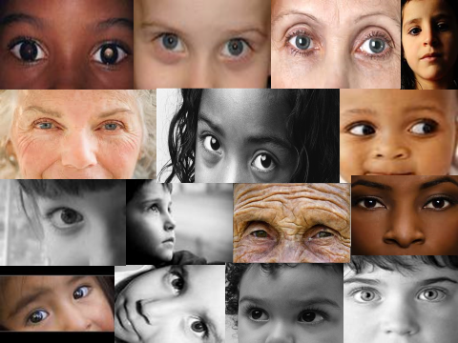
Volunteers, Safeguarding and the Church of England
ART Conference
2nd of March 2019

Slide 2
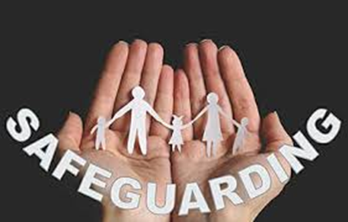
What is Safeguarding?
Safeguarding means protecting people's health, wellbeing and human rights, and enabling them to live free from harm, abuse and neglect. It's fundamental to flourishing Christian communities and is evidenced in good pastoral care.
Notes:
KEY MESSAGES:
Explain that safeguarding and caring are embedded in pastoral care.
Safeguarding children, young people and adults who may be vulnerable includes:
Protecting their rights to live in safety, free from abuse and neglect
Protecting them from maltreatment or things that are bad for their health or development
People and organisations working together to prevent the risk of abuse or neglect, and to stop them from happening
Making sure people's wellbeing is promoted, taking their views, wishes, feelings and beliefs into account
How we treat each other means that we are valuing and including one another and treating one another with respect
By enabling all people we ensuring that everyone can worship and pursue their faith journeys with encouragement and in safety
Giving people choices, independence and opportunity to contribute and share their gifts strengthens the way we treat one another and ensures that people feel enabled
Every human being has a value and dignity which comes directly from the creation of male and female in God’s own image and likeness.
All people bear the image of God. It is the Christian duty of everyone to recognise and support those who are identified as being more vulnerable.
We also need to ensure that we take care in the relationships that we build that these principles are maintained particularly if there is an imbalance in the power of relationships or where one person could be dependent upon another.
Briefly ask – What are we safeguarding against? Refer to handout 1 for more detailed guidance of the different categories of abuse.

Slide 3
Who are we safeguarding?
Children and young people
Adults at risk of neglect and abuse
Survivors of abuse
Those who pose a risk to others
Church officers, leaders, helpers
Notes:
KEY MESSAGES:
Within the church context we are safeguarding everyone!
By children and young people we are talking about everyone under the age of 18. Working together to Safeguard Children 2015 is excellent guidance.
Adults are assumed to be in need of protection when circumstances exist that warrant it. Care Act 2014 and it’s accompanying Statutory Guidance defines an adult in need of safeguarding as:
The safeguarding duties apply to an adult who:
has needs for care and support (whether or not the local authority is meeting any of those needs) and;
is experiencing, or at risk of, abuse or neglect; and
as a result of those care and support needs is unable to protect themselves from either the risk of, or the experience of abuse or neglect.
Many people have experienced abuse and are therefore on a journey of survival. The church can provide a place for sharing and healing and has an invaluable role to play in protecting survivors of abuse.
Who did Jesus say we have a duty to Safeguard, to protect?
Children – they have a right to come to know God in safety. (Matthew 19 v 14 – Suffer the little children to come unto me for of such is the Kingdom of heaven)
Adults: Those who are hungry, thirsty, in prison, homeless, sick, disabled, strangers, those subject to threats and abuse by others, those who are treated unfairly by society.
What about sinners? We know that God rejoices in the return of the prodigal son, the Lost Sheep, so if those who have harmed others in the past repent and come to church we should welcome and safeguard them by supporting them not to commit further offences – whilst always watching out for the wolf in sheeps clothing who may harm the rest of the flock.
It can sometimes be difficult to integrate people who pose a risk to others into church life. We question how they could do the things they have done. However, offenders and people who pose a risk to others often find comfort in church as they seek forgiveness and the opportunity to move on and leave their past behind them. Where risk exists confidential worship agreements are a tool to help manage this.
Because of the roles that people undertake in the church such as supervising activities and providing pastoral care there are also some vulnerabilities for church officers, leaders and helpers. Paul, in his letter to the Ephesians was very aware of this – he says: Walk in love, as Christ loved us and gave himself up for us, a fragrant offering and sacrifice to God. But sexual immorality and all impurity or covetousness must not even be named among you, as is proper among saints. Let there be no filthiness nor foolish talk nor crude joking, which are out of place”
The final point that we must acknowledge is that we are safeguarding the mission of Christ and the reputation of the church – we want it to carry the reputation of care and safety.

Slide 4
What counts as safeguarding information?
Child discloses alleged abuse
Adult discloses alleged abuse
Adult or child discloses concern for another child or an adult
You notice signs of potential abuse of a child or adult
You notice specific vulnerability of an adult or a child
Disclosure regarding an offender against a child or an adult
Behaviour by an individual which poses a risk to others or themselves
Notes:
KEY MESSAGES:
Explain that concerns might be prompted in a number of ways and could be in relation to either current or non-current abuse – run through the list. A disclosure could be made in person or in writing.
Don’t ignore the UH-OH feeling
Explain that concerns might be prompted in a number of ways – run through the list
When might someone disclose abuse?
On the news/media
Someone else might be harmed
When someone asks
When the symptoms are too great to ignore
How you might find out about abuse…
A child, young person or adult tells you what has happened or you witness abuse directly
You see an injury or behaviour consistent with abuse and which is unlikely to have been caused another way
Abuse is disclosed by someone else who knows the child, young person or adult
Indications of abuse are seen in artwork, play or creative writing
Through posts on social media or the internet
Anonymous sources tell of abuse
It can be hard for someone to admit they are being abused.
Some victims do not report abuse because they:
Are afraid of retaliation
Think its their own fault
Think they will be out in an institution
Are afraid of the consequences of disclosure
Are ashamed
Think that the Police or Social Care agencies cannot really help them
Think that no one will believe them
It happened a long time ago
These reasons may have been reinforced over time by the person’s abuser.
If you are aware of, or suspect abuse, it is your duty to take action to protect others even if the person doesn’t agree.
If you are worried someone is being abused – RECORD IT! REPORT IT!

Slide 5
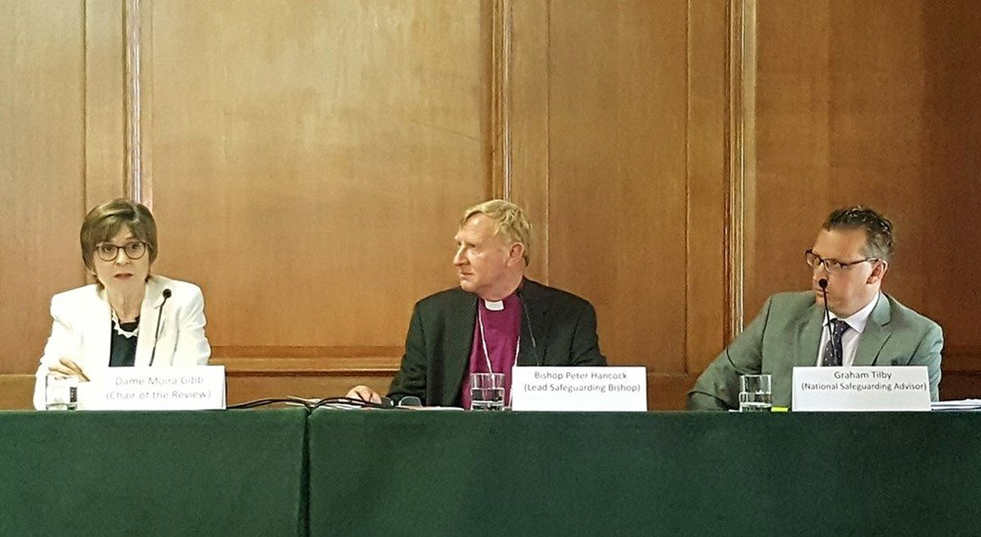
The Independent Peter Ball Review ‘An Abuse of Faith’
How are we doing?
We have no doubt that the Church has a genuine commitment to meeting its responsibilities towards the victims of abuse. However we can see how difficult it is to make change across the complex structures of the Church. Progress has been slow and continuing, faster improvement is still required. It is the leadership of the Archbishops and Bishops which will determine whether change is effective."

Slide 6
What is the ‘IICSA’?
Independent Inquiry with statutory powers
Institutional failures to protect children
Institutional responses to adults survivors of abuse

Slide 7
What can we do to reduce opportunities to abuse/re-abuse?
Open & healthy communities,
Safer recruitment & working practices
Positive use of authority, trust and influence
Effective safeguarding & pastoral response

Slide 8
How we safeguard in the church
Safeguarding means the action the Church takes to promote a safer culture.
This means we will promote the welfare of children, young people and adults, work to prevent abuse from occurring, seek to protect those that are at risk of being abused and respond well to those that have been abused. We will take care to identify where a person may present a risk to others, and offer support to them whilst taking steps to mitigate such risks.
Notes:
KEY MESSAGES:
We must promote ourselves as a safe place by telling people what we are doing in regards to safeguarding and how they could make a complaint – have a policy or safeguarding statement up on a noticeboard, and things like the Childline cards so everyone knows that as a church you take safeguarding seriously
The Church door is where safeguarding starts and is the ‘frontline’ in pastoral care. I think that it is really important that we recognise that the local setting is where people come, it is where people are looking for welcome, safety and support from our Church. It is where people feel safe to grow and where interaction takes place.
We must practice to prevent harm occurring and protect vulnerable children and adults, leaders, and the reputation of the church – following the safeguarding policies will help us to do that
We must respond well and immediately to any concerns raised following policy and practice guidance, and ensure that we always take action if someone is at risk.
We encounter safeguarding issues in the church when there are concerns about church officers; within the church community and congregation when we might be told something about family or school life, or in a residential home; and from parishioners whom we might visit for pastoral care. If we are given safeguarding information, we have to act on it.
The following key principles underpin the Church’s approach to safeguarding practice:
The welfare of the child, young person and vulnerable adult is paramount;
Integrity, respect and listening to all;
Transparency and openness;
Accountability;
Collaboration with key statutory authorities and other partners;
Use of professional safeguarding advice and support both inside and outside the church;
A commitment to the prevention of abuse
The active management of risk;
Promoting a culture of informed vigilance; and
Regular evaluation to ensure best practice.

Slide 9
Safeguarding within the Bell Ringing Community
Collegiate community of ringers. Sometimes referred to as a “folk art”
The culture of ringing is that you are free to join in any ringing for practice or for service anywhere and will be welcomed
A perception by some that safeguarding is not a serious concern
Wide age range 6 to 90’s
Travel and outings are involved. Group of towers are visited for meetings, open days, ringing holidays, peals and a host of other occasions when ringers get together
These factors can sometimes create risk and inhibit the recognition and reporting of concerns
Notes:
Some might suggest that safeguarding is only relevant in external pastoral work and does not apply to the internal life of the community. However exploitation and abuse is most likely when vulnerability meets power. This can happen both within and outside the community. Some recent key findings from the National Crime Agency research4 into abuse in institutional settings are set out here. While the research applies to children and mainly relates to sexual abuse, in many cases the comments made could also apply to adults:
The culture within an institution has a strong influence on the degree to which abuse might occur within it. Poor leadership, closed structures, ineffective policies and procedures together with the discouragement of reporting, facilitates a malign climate which colludes with those inclined to ……. abuse children [ and adults experiencing, or at risk of abuse or neglect’].
Where institutions are held in high regard and respected by the communities they serve, positional grooming can be perpetuated, whereby offenders conduct social or environmental grooming and mask their actions by virtue of their formal positions within an organisation.
Intense loyalty and conformity of workers to the mission, norms and values of an institution can inhibit them from reporting concerns.
The historic nature of many cases currently exercising media attention, together with developments in safeguarding, might give a false perception that this type of offending can no longer occur. Offenders continue to exploit systemic vulnerabilities where they exist.”
hi

Slide 10
What does C of E policy guidance say?
Safer Recruitment
Tower Captains, Deputy / Assistant and bell ringing teachers/trainers must be safely recruited in line with their responsibilities to:
1) Teach or train children
2) Manage those that teach or train children in accordance with the Church of England Safer Recruitment Practice Guidance.
It is the responsibility of the Tower Captains and the local PCC to ensure that this happens.
This guidance can be found at:
https://cccbr.org.uk/wp-content/uploads/2017/10/GN3-Child-Protection-Issue-12-Oct-2017.pdf

Slide 11
Roles that Require a DBS Check
Activity | Supervision by | DBS Checking By | Any new checking
Directly caring for, teaching, training or supervising children by tower captain, deputy/assistant/bell ringing teachers/trainers or visiting tutors | Tower Captain/Deputy or Assistant | PCC via the Diocese | PCC
Transporting children as formal arrangement Irrespective of frequency | Driver organized by the Church or Guild | PCC via the Diocese | PCC

Slide 12
Roles not eligible for a DBS check
Ringers in general supporting roles
Unplanned one-off teaching or deputising in an emergency
Transporting children as part of arrangements between families

Slide 13
Safeguarding Training
Requirements by role | Tower Captain or Leader or Deputy | Trainer of children | Rank and File Bell Ringers | Notes
Role Description and Appointed by the PCC | Yes
DBS Check | Yes | Yes
Basic Training CO online | Yes | Yes | Yes | Every 3 years
C1 Foundation | Yes | Yes | Yes* | Every 3 years
C2 Leadership | Yes | Yes |  | Every 3 years
S1 – Safer Recruitment * | Yes |  |  | Every 3 years
S3 Domestic Abuse* | Yes

Slide 14
Best Practice Principles
Children and young people in mixed-age bell ringing must be appropriately supervised. These activities must have at least two adults present.
Leaders must be being available to the children/young people if they wish to report a concern, and ensure concerns are reported to the local nominated safeguarding officer, PSO, or DSA

Slide 15
Best Practice Principles
All local ringing societies should appoint a Safeguarding Officer, someone who can oversee and manage safeguarding matters.
Good liaison should be established between Tower Captains and PCCs and between the Safeguarding Officer of local societies and the Parish and Diocesan Safeguarding Adviser.
It is the responsibility of all visiting groups to ensure that those leading/supervising a group have had all relevant checks. It is not the responsibility of the host church, unless the host church is providing the leader/supervisor for a visiting group.

Slide 16
Best Practice Principles
Parents’ consent in writing should be sought prior to commencing teaching, outings or Guild meeting visits
Parents should be invited to training sessions where possible so they understand the structure of lessons and how their child is being taught.

Slide 17
Best Practice Principles
Keep an attendance register, which all attendees must sign, so that everyone is aware who was present.
Children must be supervised at all times and should only be allowed into hazardous locations, such as the bell chamber, when accompanied by the Tower Captain / Deputy or Assistant

Slide 18
Best Practice Principles
Always have two adults (preferably one of each gender) present whenever children/young people are ringing or being supervised, taught or transported
Touching should be only done when appropriate for teaching, supervision and/or in an emergency. Those helping children by ringing another bell or standing nearby should be aware of the need to protect personal space.

Slide 19
Safeguarding and Bellringing in the Anglican Church
Bell ringing in an Anglican Church falls under the safeguarding policy and practice guidance
Bell ringers must be safely recruited and trained (C0 and C2 for Bell tower captains and DBS checks when required)
The PCC has responsibility for safeguarding ringing activity in parishes
In a Cathedral, Dean and Chapter?
Important to establish good safeguarding practice to maintain the integrity of bell ringing as it is important this church tradition continues
If you have a concern, consult the tower captain or parish safeguarding officer. You can always ring the Diocesan Safeguarding Advisor for advice
Immediate concerns, ring police or 999

Slide 20
What would you do? Who would you tell?
Case studies

Slide 21
TIME FOR QUESTIONS & DISCUSSION Thank You

