Slide 1


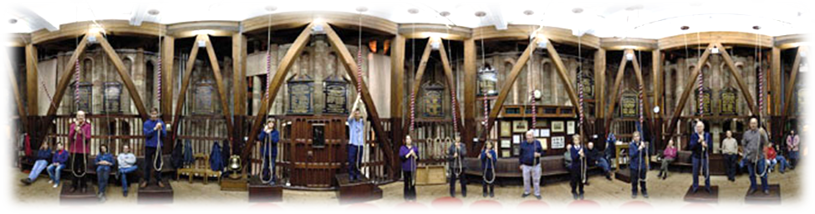
INSPIRING LEADERSHIP
Workshop for local tower captains
and district officers
March 2016
Notes:
Pre-work:
- complete “Inspiring Leader” self online review (with option for ‘others’)
Materials:
mini-workbook each with copies of slides and worksheets
cards to sort
EXTRA NOTES:
ADD RE INTEGRITY
ADD VIDEO CLIPS OF PEOPLE TALKING ABOUT GOOD RINGING MASTERS??

Slide 2
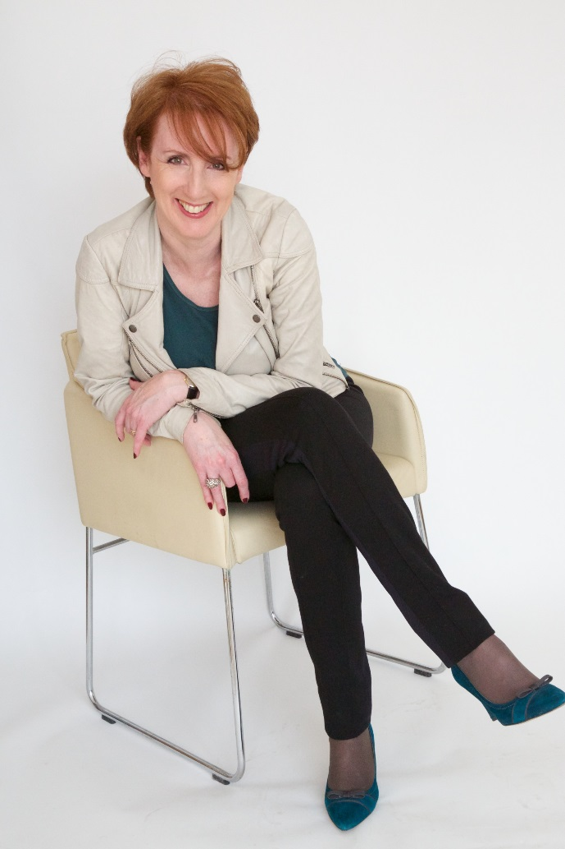
Introductions
Notes:
XXX

Slide 3
What will you get out of this workshop
Opportunity to reflect on your role and accountabilities
as a leader in ringing
An introduction to the situational model of leadership
A chance to apply a six-step approach to making a difference
A chance to share common issues with others
Increased confidence in communicating with other ringers
and the Church
A clear focus and plan for moving forward
Clarity on your strengths as a leader
Notes:
XXX

Slide 4
Outline
Introductions
Defining leadership
Getting clear what you want
Your skills
The situational leadership model
The six-step approach
Your commitment
Summary
Notes:
5 MINS
Talk through list adding that there will be a mix of full group discussions, small group work and paired sharing.
Invite them to participate fully and suggest the more they bring the material to them, the more they will get.
Inform re workbook.

Slide 5

Notes:
3 mins
Lead facilitator to introduce themselves, describing experience and giving their credibility as a:
Ringer
Leader
Leader of ringers
Trainer of leaders

Slide 6

Introductions
Introduce your partner
Name
Accountability
What do you find easy?
What do you want help with?
Notes:
20 min (depending on numbers)
Let’s see who is in the room and do this by being leaders and introducing each other.
Take note of how this feels for you – check what your intention is and also how it feels to be introduced and ‘promoted’ by someone else.
Ask them to note in their workbook what they want from the day.

Slide 7

What is leadership?
Notes:
10 mins
Full group exercise – facilitator flips up key points raised (or creates mind map on flip chart)

Slide 8
Leadership (1)
Leadership is the capacity to translate vision into reality
(Warren Bennis)
There are many,
varied definitions:
If your actions inspire others to dream more, learn more, do more and become more,
you are a leader
(J Quincy Adams)
A leader is one who knows the way, goes the way, and shows the way
(John C Maxwell)
Leadership is about taking responsibility, not making excuses
(Mitt Romney)
Leadership at one time meant muscles; but today it means getting along with people
(Mahatma Gandhi)
Notes:
3 mins
Note how it is seen in many different ways.

Slide 9
Leadership (2)
Example is leadership
(Albert Schweitzer)
Time is neutral and does not change things. With courage and initiative, leaders
change things
(Jesse Jackson)
The (leader) generally gets the (followers)
he deserves
(J Paul Getty)
Management is about arranging and telling. Leadership is about nurturing and enhancing
(Tom Peters)
Only the guy who isn’t rowing has time to rock the boat
(Jean-Paul Sartre)
Notes:
5 mins
Give time to reflect and ask for further points.
Invite them to write down their favourite/personal definition in their workbook.

Slide 10


Slide 11
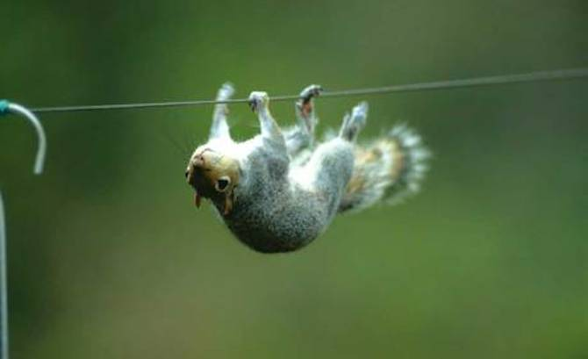
What are the key challenges we face?
Notes:
20 mins
Small group discussions to agree three challenges then each person asked to give top challenge

Slide 12
Challenges in ringing
Musical performance
Long learning time
Voluntary activity
Shortage of conductors
Relations with church
Bell maintenance and
church fabric
Safety issues
Child safeguarding issues
Band motivation
Finding new learners
Lack of ringers
Conflicts in the band
Notes:
2 mins
Refer briefly to this list in case big areas not covered already.
Ask them to note biggest challenge in their workbook.

Slide 13
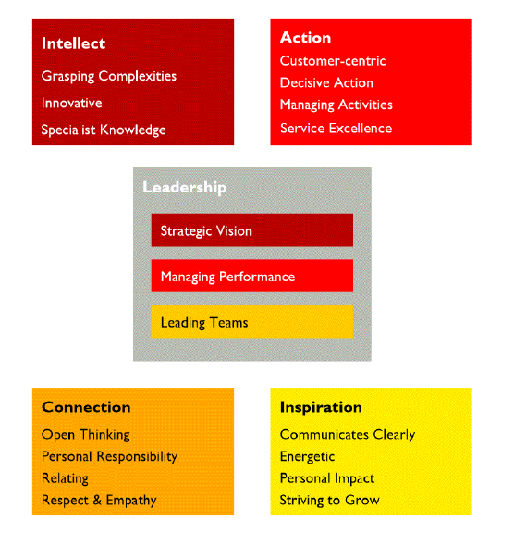
Your skills
The
Inspiring
Leader
Model
Notes:
30 mins
Explain turning now from the “what” to the “how” by looking at the skills you have…
Hand out their Inspiring Leader self/other reviews and ask them to discuss it with a partner.
Ask them to note key strengths and weaker areas in their workbooks.

Slide 14

Developing key skills
Notes:
10 mins
Ask them to review their priority tasks in the light of their skills and select one skill to focus on.
Refer to neuroscience and ask them to get clear what they want this to look like in the future ie to vision the ideal state.
Ask for examples to work with. Ask them to note these and to consider what actions they might take to get there.

Slide 15
Methods of developing key skills
Observing
Mentoring
Being mentored
Sharing
Requesting help
Coaching
Recruitment
Organising Sunday ringing
Organising quarter peals
Reading
Logging
Recording
Maintaining
Experimenting
Notes:
5 mins
Refer to learning styles and say reference later.o

Slide 16

Bullet
Bullet

Slide 17
Different styles of leadership
Play TED talk video
“Lead like the great conductors”
Itay Talgam
https://www.ted.com/talks/itay_talgam_lead_like_the_great_conductors?language=en#t-78670
Notes:
10 + 15 mins
Introduce clip by saying let’s see how styles of leadership can differ
[PLAY VIDEO: https://www.google.co.uk/#q=ted+talk+conductors]
After video – talk about how each style is valid and effective, and has different impact.
Ask them to discuss what their preferred style might be in pairs.
Ask them to note in their workbook which conductor they think they most naturally are.

Slide 18
Modes of communication that make a difference
Making a request
Giving an invitation
Making an offer
Making a promise
Making a declaration
Making an assertion
Proposing a deal
Responding with a “yes”
Responding with a “no”
Stating a commitment
Making a denial
Rescinding an offer
Revoking a promise
Confirming an agreement
Notes:
2 mins
Refer briefly to this list in case big areas not covered already.
Ask them to note biggest challenge in their workbook.

Slide 19
Foundations of powerful communication
Known to be your word
Being related
Mutual trust
Mutual respect
Notes:
2 mins
Refer briefly to this list in case big areas not covered already.
Ask them to note biggest challenge in their workbook.

Slide 20
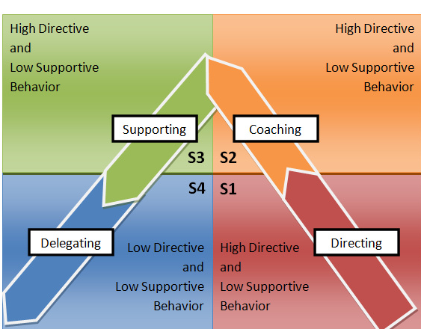
Situational Leadership Model (Hersey-Blanchard)
High
Supportive Behaviour
Low
Directive Behaviour
Low
High
Notes:
10 + 15 mins
Introduce clip by saying let’s see how styles of leadership can differ
[PLAY VIDEO: https://www.google.co.uk/#q=ted+talk+conductors]
After video – talk about how each style is valid and effective, and has different impact.
Ask them to discuss what their preferred style might be in pairs.
Ask them to note in their workbook which conductor they think they most naturally are.

Slide 21
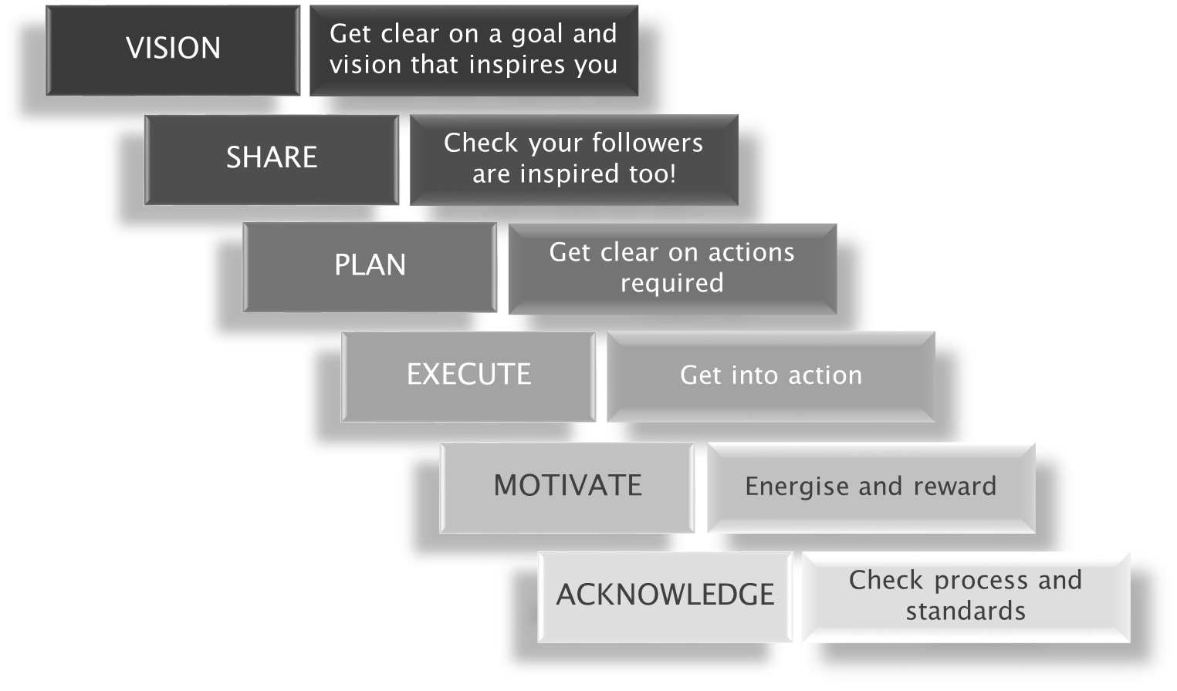
Six steps to success
Notes:
10 mins
There is a process to follow as a leader – talk through each step and explain there are top tips to follow.

Slide 22

Vision and goals
Co-creation is best
Between fantasy and predictable
Inspires
Be specific and graphic
Describe how success will feel
Notes:
10 min
Ask them to note down a potential goal for their ringers in their workbook.

Slide 23
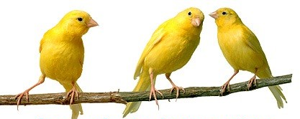
Share
Ensure all stakeholders are on board
Check key personnel are inspired
Be brave and talk!
Find leaders
Notes:
10 min
Ask them to note who they would need to get on board.
Include the clergy!

Slide 25

Engage
Create an occasion or event
Invite ringers powerfully
Be prepared for a “no”
Thank them for their feedback/
consideration
Remind them of their interest
Notes:
5 min

Slide 26

Notes:
5 min

Slide 27
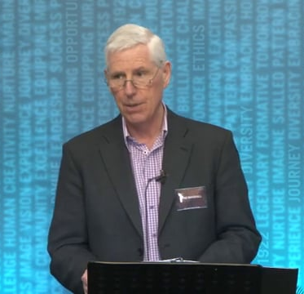
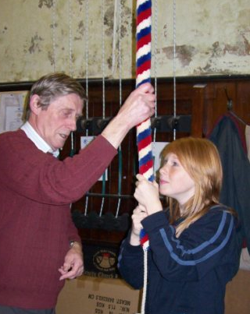
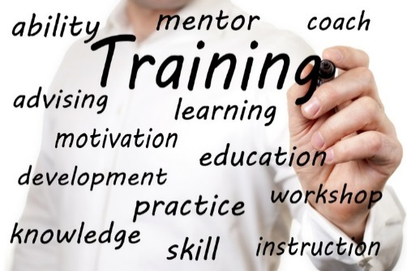

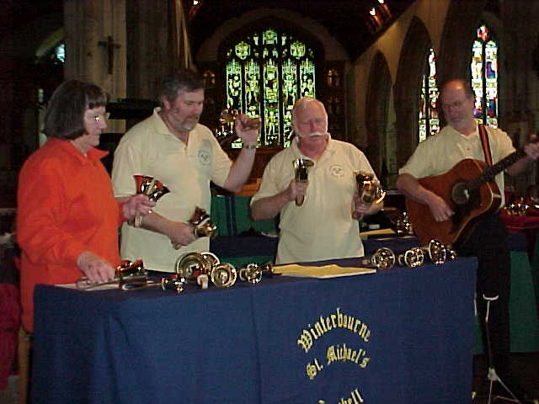
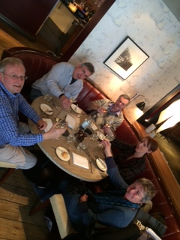
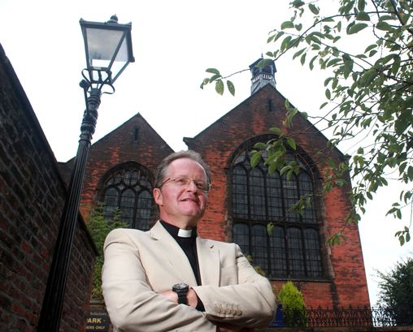

Deliver
Notes:
5 min

Slide 28

Motivate
Make sure your practices are enjoyable
Having fun is important in
the early stages of ringing
Flexible teaching style
Make your teaching learner-centred
Close communications – asking and listening as well as telling
Really get to know the members
of your band and what makes
them tick
Notes:
5 min
Motivation is the key to progressing your band.
Good communications with your band members is important.
A Tower Captain should listen to and try to understand their ringers.

Slide 29

Set a good atmosphere in the tower
Place emphasis on
Personal effort
Striving to succeed
Skill development
Do not regard mistakes as
failures
They provide opportunity for feedback and are essential
to the learning process
Notes:
5 min
A good atmosphere in the tower will help keep your ringers feeling good and feeling focused!

Slide 30
The importance of experiencing success
Success leads to confidence
Confidence leads to more effort
More effort leads to more achievement
Achievement leads to a feeling of success!
Success
Achievement
Confidence
Plan your ringers’ progress
in steps they can achieve
Effort
Notes:
5 min
Plan your ringers’ progress carefully, building each achievement on the last one in small steps the individual can cope with.

Slide 31
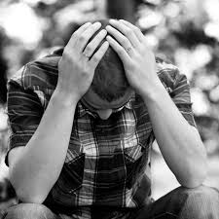
Repeated failure is demotivating
Leads to frustration and loss of confidence
Loss of confidence leads to reluctance to try things and have a go
Less effort is put in
Less effort leads to lack of
achievement and more failure
Eventually leads to reduced attendance and probable loss of your ringer
Notes:
5 min
If the tower captain sets targets which are too hard the ringer cannot succeed.
Be very careful that you progress your ringers in steps that they can cope with. These steps will be different for different ringers.
Your slower learners need small steps and your faster learners need greater challenges to keep them focused.

Slide 32
Acknowledge results
Tell the truth
Speak from the heart
Bring humour and gratitude
Take
responsibility
Notes:
5 mins

Slide 33

Top tips for tower captains
Delegate responsibilities
Share the teaching broadly eg ITTS courses
Have everyone conduct
Plan regular social activity
Invite clergy into the team
Plan ahead for each touch and each practice
Ensure every ringer has their next step clear
Build in theory work and special
performances into schedule
Notes:
10 min

Slide 34

So what does ‘success’ look like?
Notes:
20 mins
Paired work to agree how they personally define success (over coffee).
Ask them to note:
How they are defining success in their workbook.
What they have right now.
What is missing that would make a difference.

Slide 35
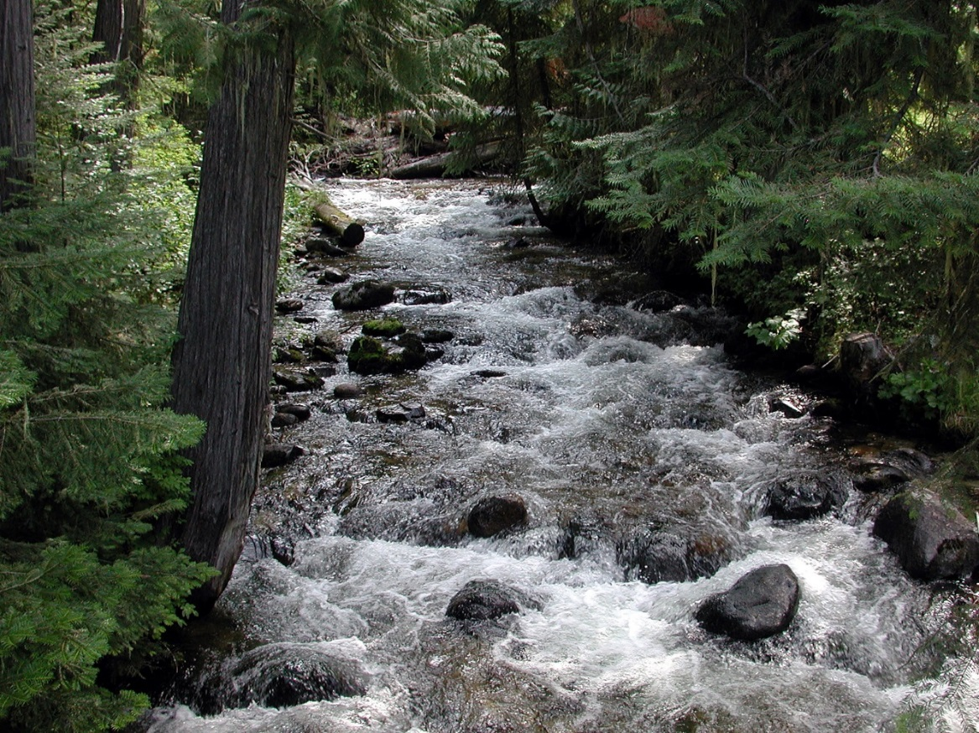
You as the source
Notes:
10 mins
Talk about how they are at the source of their current situation – their NOW.
It is of their creation.
It is their car parking space.
It is how they impact.

Slide 36

Your accountabilities
Definition:
“Obligation to account for activities, accept responsibility for them and disclose results”

Slide 37
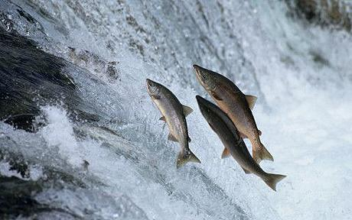
Commitment
Being leader is about engaging commitment
Let’s start with yours
Notes:
20 min
Ask them to note in their workbook:
What are they going to focus on in the future?
What steps are they going to take to develop their leadership? (list them)

Slide 39

Make a difference!
Notes:
20 min
Ask them to note in their workbook:
What are they going to focus on in the future?
What steps are they going to take to develop their leadership? (list them)

Slide 40
SUPPLEMENTARY
TOP TIPS
Notes:
5 min
The tower captain needs good relationships with the local community and the church community.

Slide 41
Direct and deliver community needs
The Church
Bellringers
The
Community
Ring for events in the community
Publish activities and achievements on your or a community website and Facebook
Get mentions in local press/radio
Notes:
5 min
The tower captain needs good relationships with the local community and the church community.

Slide 42
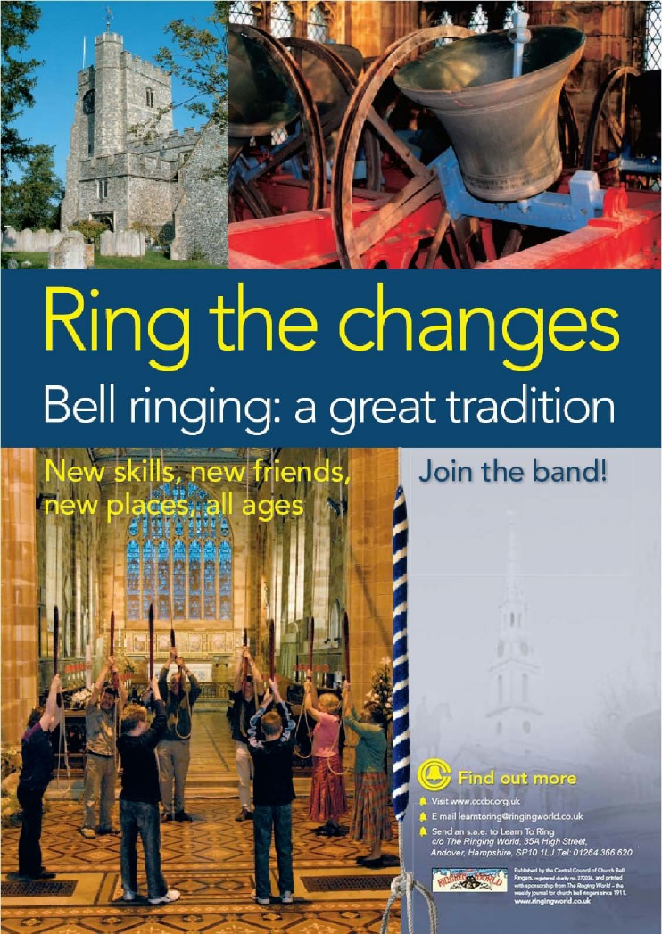
Recruit some ringers
How often?
Who?
  Bring a friend
Advertising
  How?
  Where?
Open days/taster sessions
Teaching handling
  Sufficient teachers?
Be proactive –
they won’t come to you
Notes:
XX min
Active recruitment will be needed every couple of years. At the time it may seem a shame to fill the tower up with beginners once you have just got the previous ringers to a reasonable stage.
You need to think about who you want to attract. This decision will affect where and how you advertise!
It is important to keep a high profile in the locality so people know who the ringers are- sometimes this personal approach, produces good results. Such as bring a friend initiatives.
Open days and taster sessions can be useful for recruiting and just for public relations.
Before you recruit you need to decide how many teachers you have and therefore how many can you teach at one time?

Slide 43

Good communications with your clergy
Good channels of communication will lead to good relationships
Consider inviting the vicar to tower social events
Write articles for the church magazine
Church wardens are present before services which provides opportunity to have conversation with them.
Church wardens are close to vicars and can be an ambassador for the ringers
Notes:
XX min

Slide 44
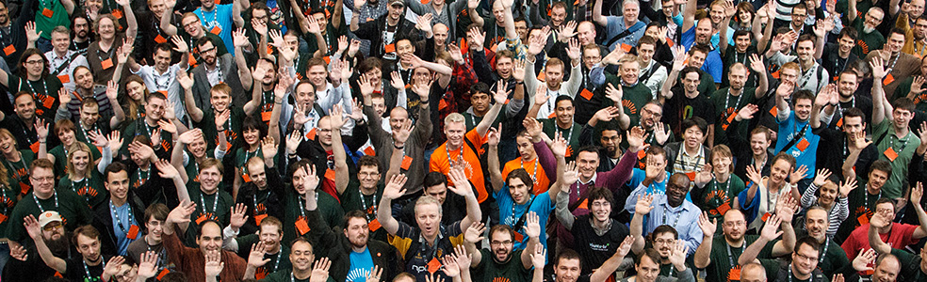
Good communications with the local community
Join in with community events and get to know local people
Hold tower open days so people can see the bells
Ring at regular times
Advertise or give notice of extra ringing
Hold open days so local people can come and see the bells
Notes:
A tower captain is the link between the ringers and the community.
Other band members maybe important in this role. For example a ringer might be a local doctor, teacher, shop keeper.
Consideration should be given to the local residents when organising long periods of ringing.
Consider the difference between a sunny afternoon when local residents may be having a barbeque and a winters day when it is raining.
Advertise long periods of ringing in advance.

Slide 45
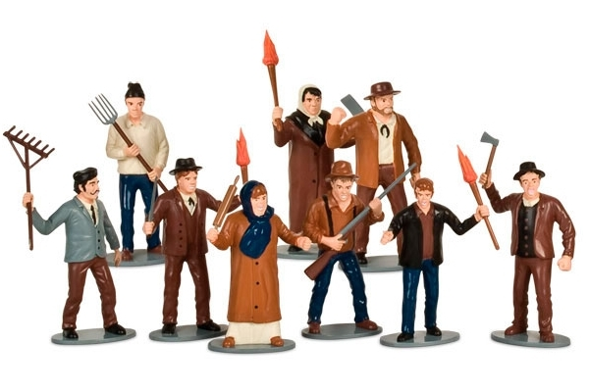
Community relations – things to beware of!
Ringing at unfamiliar times can annoy the neighbours
Long periods of ringing can annoy the neighbours
If you have a complaint, discuss with the clergy how to deal with it
CCCBR Tower Management Committee
Notes:
XX min

Slide 46
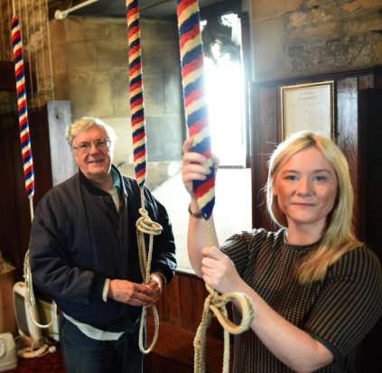
Being a tower captain
Keeps the bells ringing for the community
Keeps the band viable for the ringers
Keeps the bells ringing for the church
The tower captain is the backbone of ringing
Notes:
XX min

Slide 47
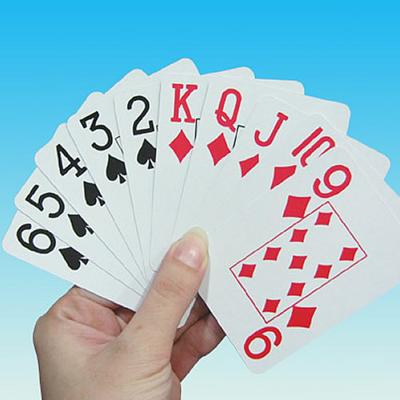
Exercise
Notes:
30 mins (with previous slide)
Card-sort exercise
Each individual given a pack of laminated cards – each with a ‘task’ on eg
Check bell frame
Organise bands for weddings
Check each ringer happy
Draft development plans
Speak with vicar
Attend district meetings
Ask disruptive ringers to leave the band
etc
Ask to select all the tasks they have accountability for and to choose top 5 priorities.
Compare priorities with partner.

