Slide 1
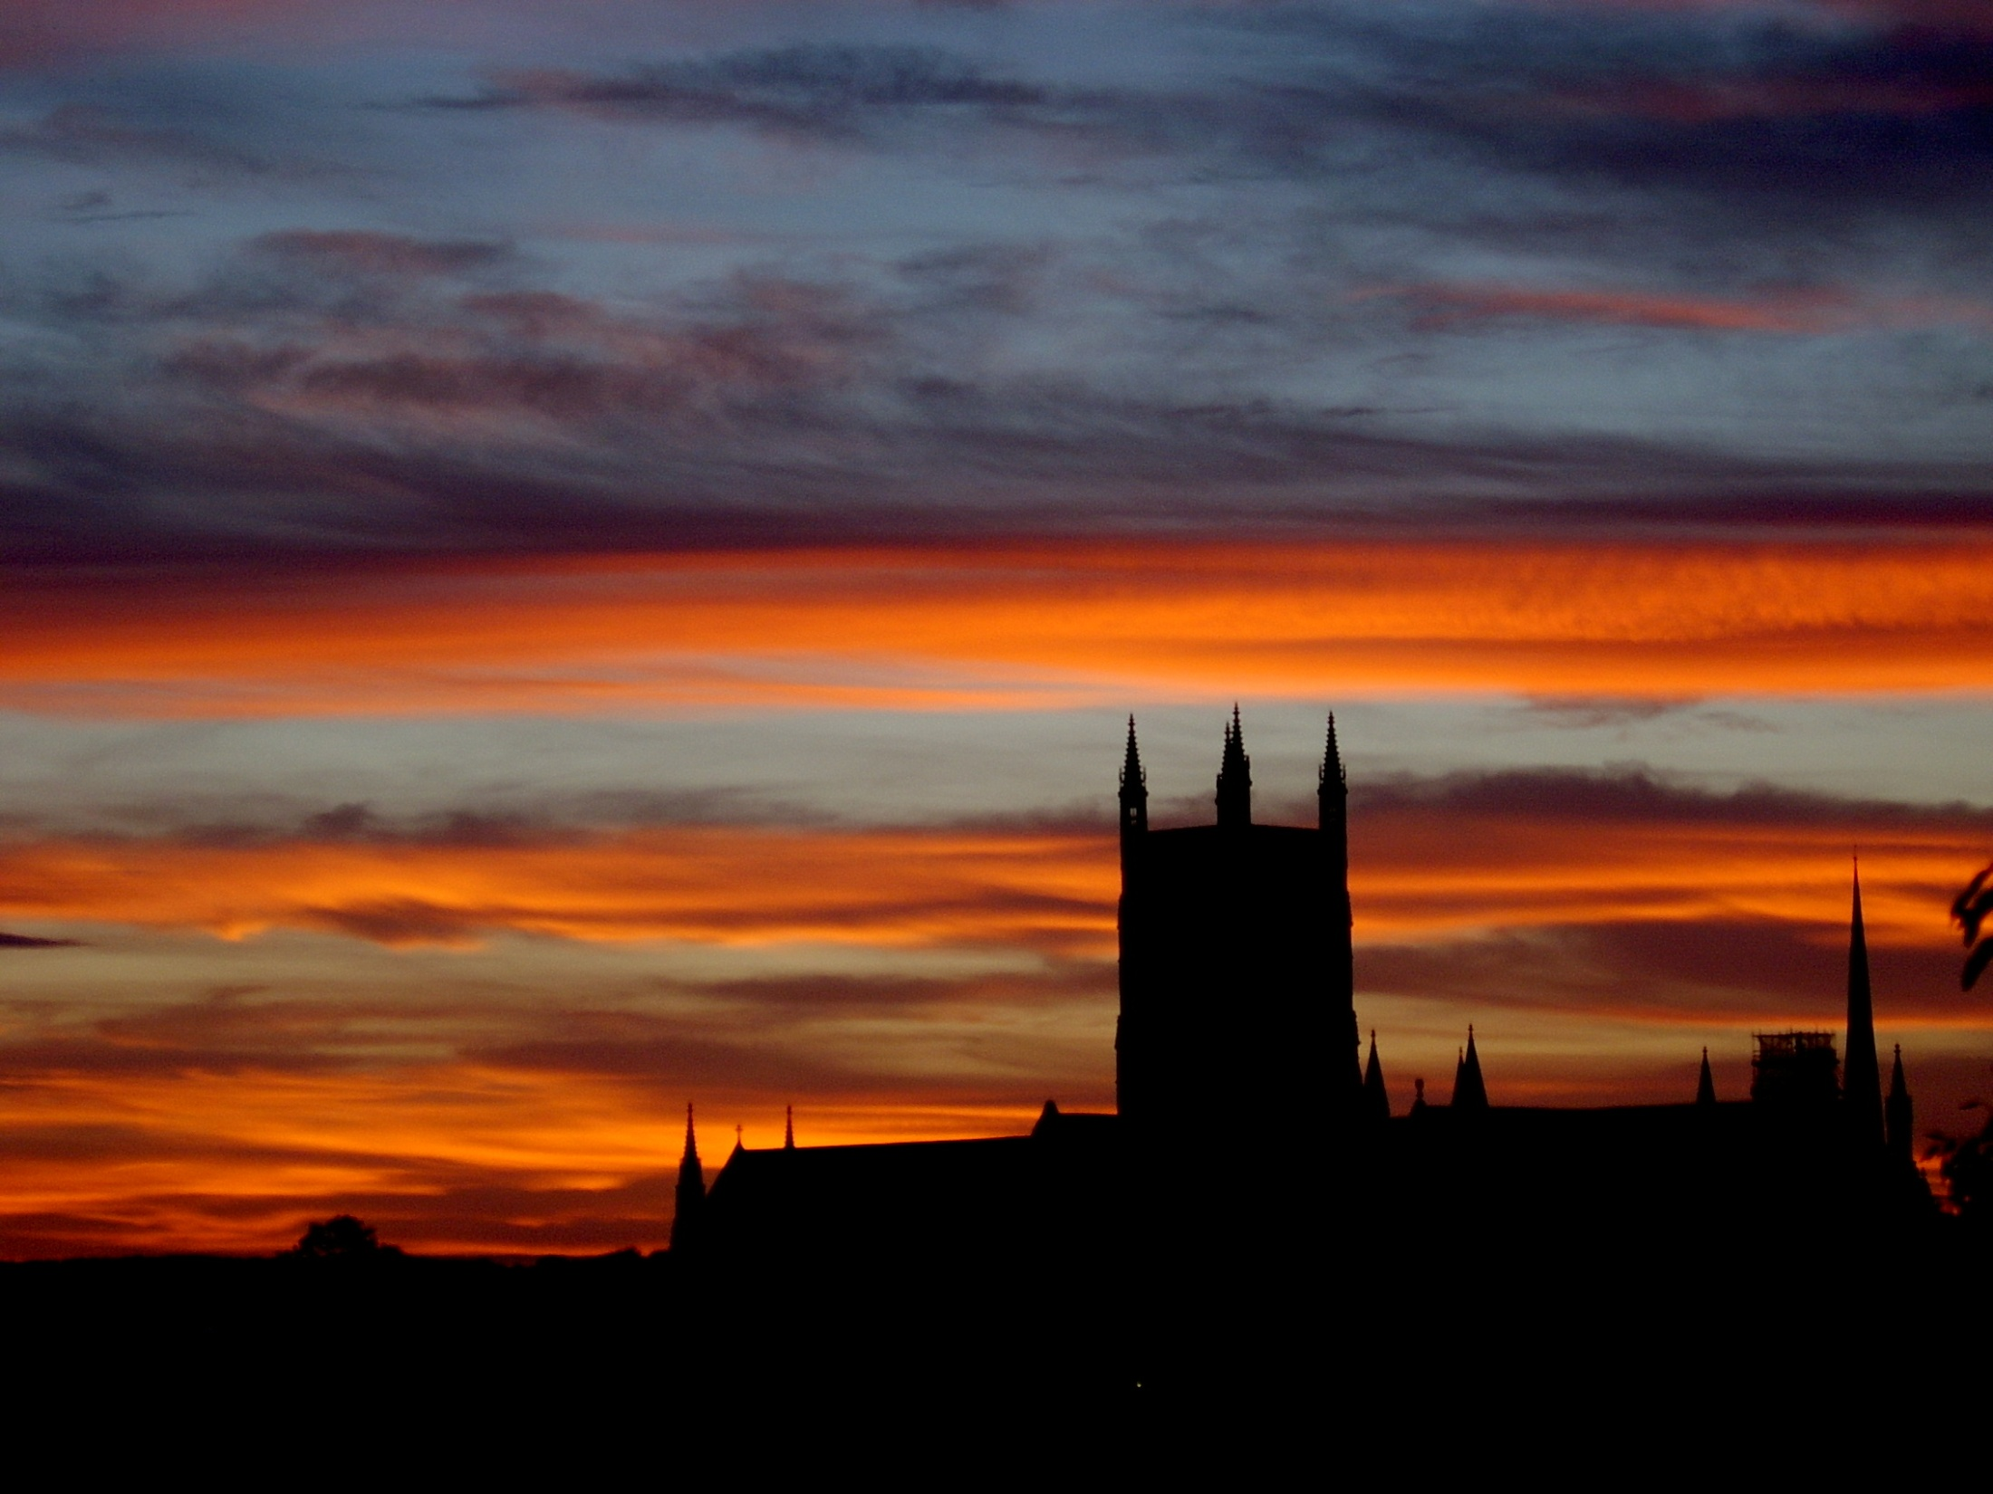
“Making things happen”
Kineton, ART agm, 9 March 2013
Mark Regan
Worcester Cathedral

Slide 2
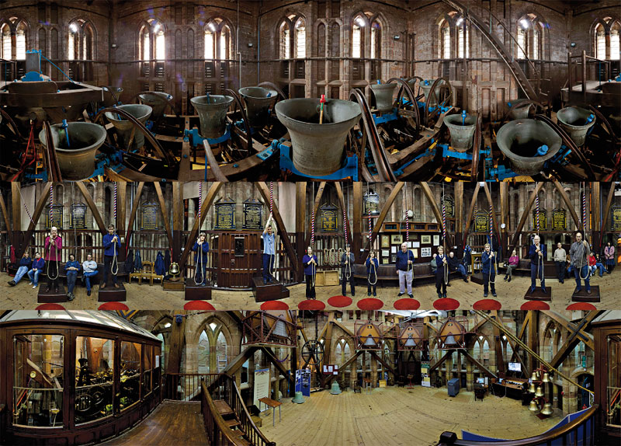
Notes:
This is a unusual view of the tower – the bells, the ringers and the TC.
Available as a jigsaw. Sold over 150.
We also sell cds and dvds

Slide 3
The only consequence is what we do

Slide 4
The local tower is the most important place in ringing

Slide 5
Worcester Cathedral
We ring on the best and hardest peal of bells
The ‘traditional’ way is not working
And is not sustainable
“You can’t teach at the Cathedral” Who says?

Slide 6
Worcester Cathedral
No history of teaching
Relied on people coming in
Or attracting ringers from afar
No purposeful engagement with the Cathedral or the community
Elitist

Slide 7
So what have we done?
Wooden clappers
Stabilised the frame and sorted out the acoustics
Teaching Centre
Two new rings of bells in Worcester
Three Worcestershire unringables are now ringable (more to come)
The Cathedral and City expect their bells to be rung
And we’ve changed how people think and do things
Notes:
Peals now 12 2 agms etc
3 in a week locals love it
Les dad armistice and royal wedding
Wccc stories

Slide 8
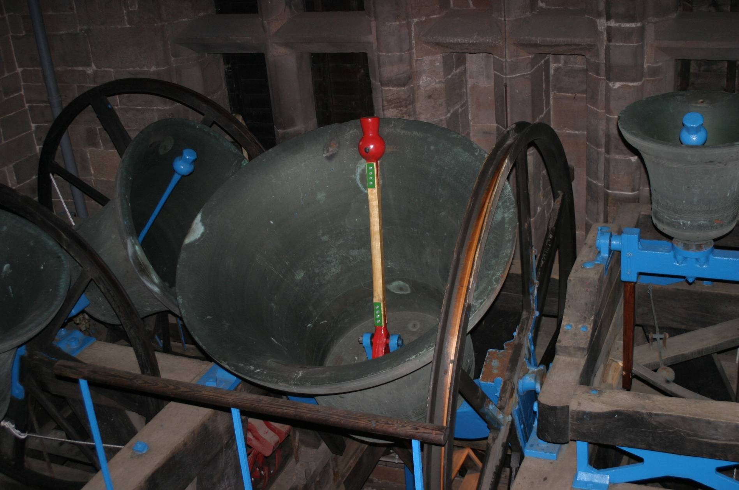
Notes:
This is the great bell – ringing it weighs 48 cwt.
Wooden clapper story – has changed things. Now others have copied us - examples

Slide 9
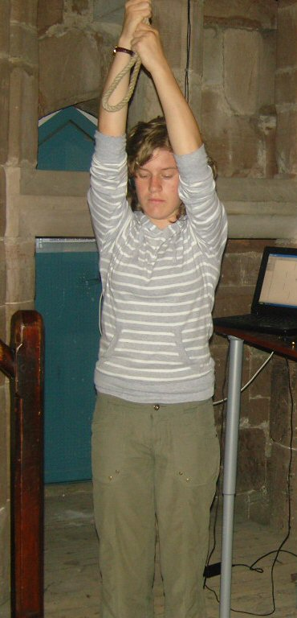

Slide 10
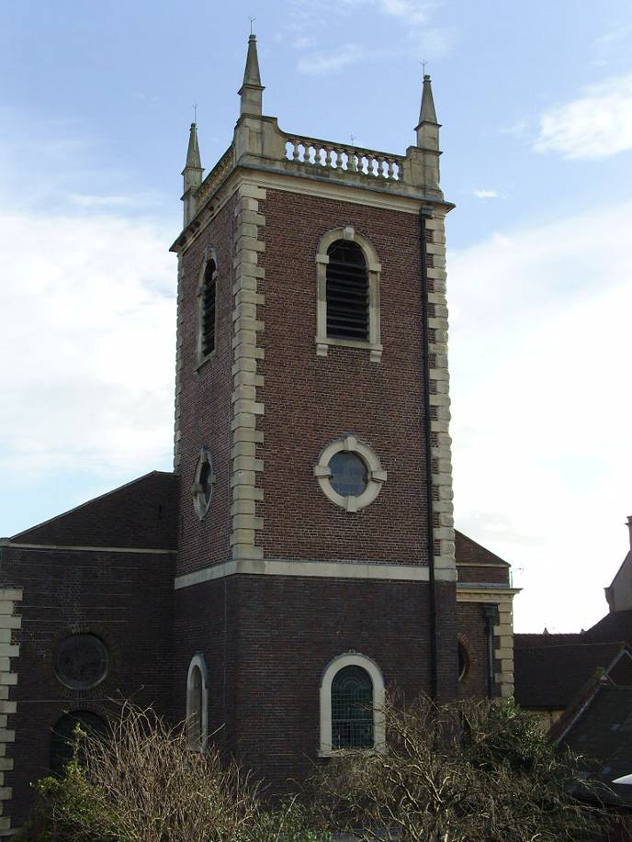
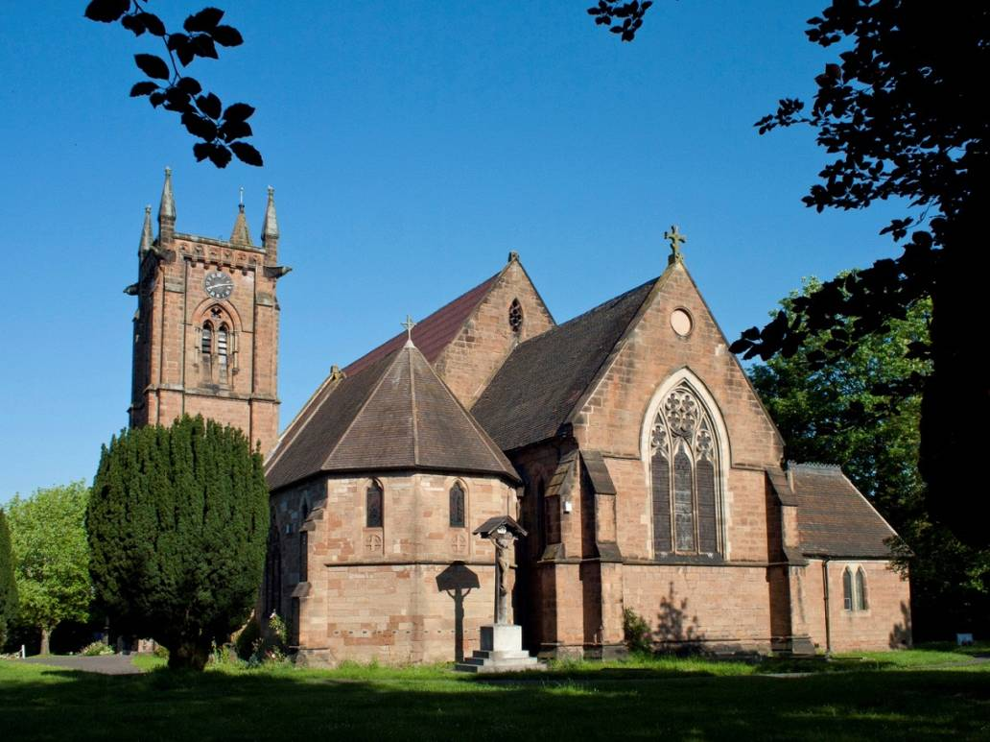
Notes:
New bells at old St Martin’s
£150,000
New bells at Barbourne
£90,000
Worcester a city of bells, so move over Oxford.
The County Archaeology service is writing an educational trail for bells in the City!

Slide 11
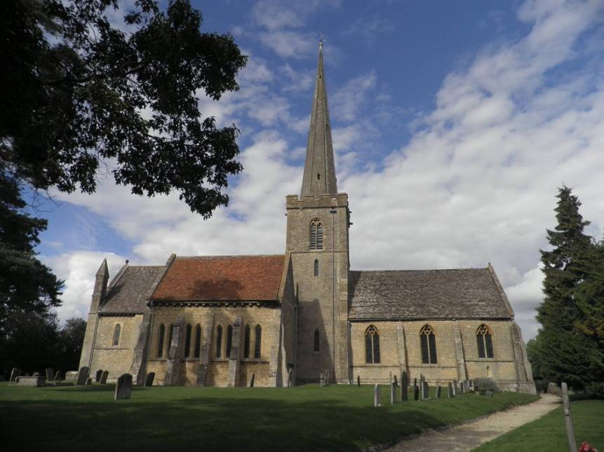
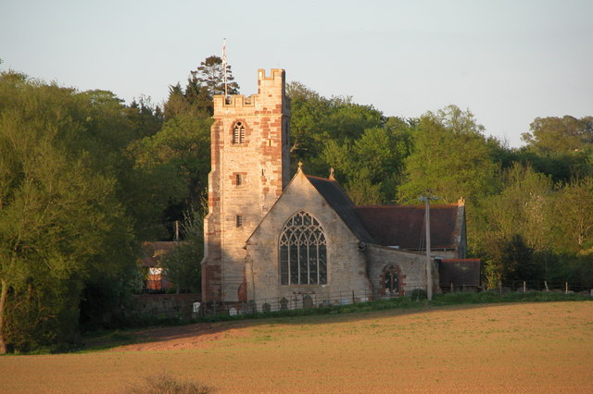
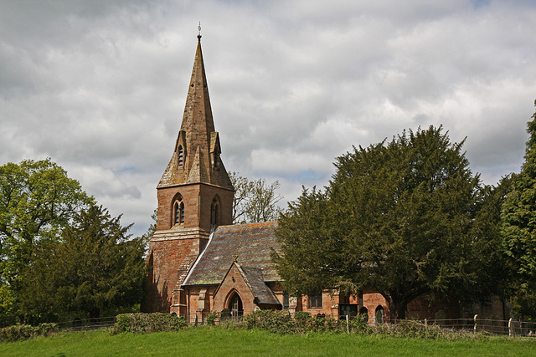

Slide 12
Status quo = inertia

Slide 13
Everything we take for granted was once new.

Slide 14
The status quo in ringing is getting so dumbed-down, we are apologising and not advocating

Slide 15
Our new ringing communities are flexible, transient, have no borders and e
Old boundaries and organisations are becoming irrelevant and unnecessary. Ringing associations need to evolve very quickly if they are to survive. What is their purpose?

Slide 16
Consequences
You will be very unpopular
You will get lots of things wrong
So if you fail, use a different approach
Some people will do their best to destabilise what you are doing
You will be very lonely
Success has many fathers and failure is an orphan

Slide 17
You can’t solve a problem with the thinking which created it

Slide 18
Do we really want change?
And the consequences?

Slide 19
The are two kinds of bellringer
Those who do
And those who don’t do

Slide 20
Ringing is in great shape
Be positive!

Slide 21
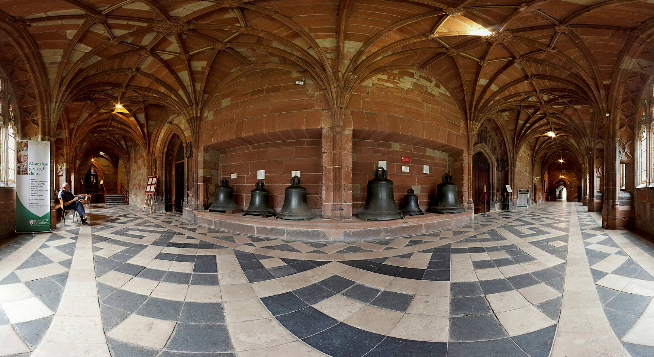
Notes:
Archaeology
Importance of the cloister bells.
Most cast in the 14thC.
Rang in civil war 1683 ringing for relief of Vienna from the Turks. 4 days later! Ringing for victory over the French – by the deans orders.
Bells told the news.
Their value. The risk.

Slide 22
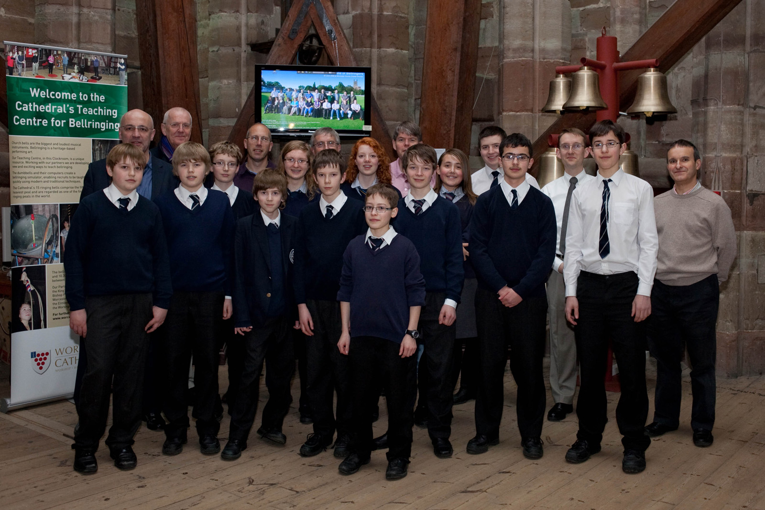
Notes:
We ring on Sundays and we teach – that’s it really.
Working with King’s. tim keyes is a ringer. Good for choristers. AAFS story.
Start working with Bishops, CW, the Chase.

Slide 23
Social engagement model
The Church
Bellringers
The Community

Slide 24
Reality
Thick stone walls isolate us from reality. We are unaware that hundreds and thousands of people hear us perform every week. We need to be responsible about the noise we make.
We are performers not hobbyists
How many people do you know who listen to your ringing?

Slide 25
Social engagement model
What does this model mean?
The Church owns the bells
The community own what we do
Bellringers are stewards and practitioners

Slide 26
The current situation
Bellringers
Ringers are stewards and practitioners
The Church owns the bells
The Community owns what we do
The Community comprises a complex group of stakeholders
80% of current effort
Church
20% of current effort
Community

Slide 27
Making things happen is easy
Bellringers
Community
Church
80% of activity

Slide 28
Worcester Cathedral’s Teaching Centre

Slide 29
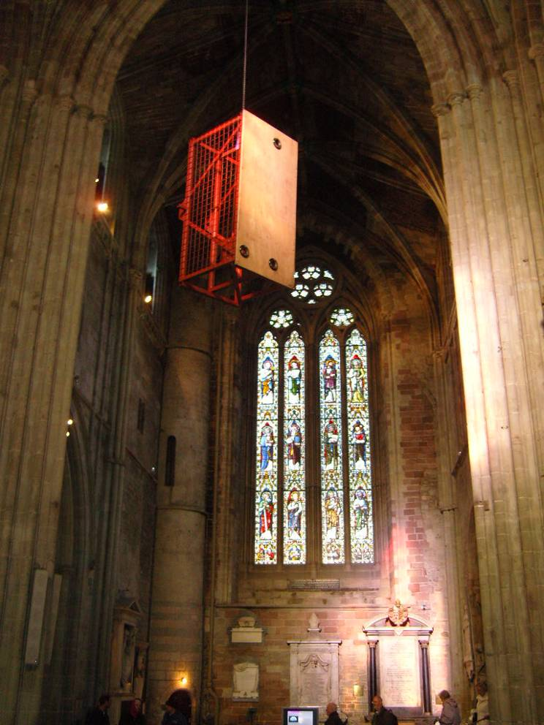
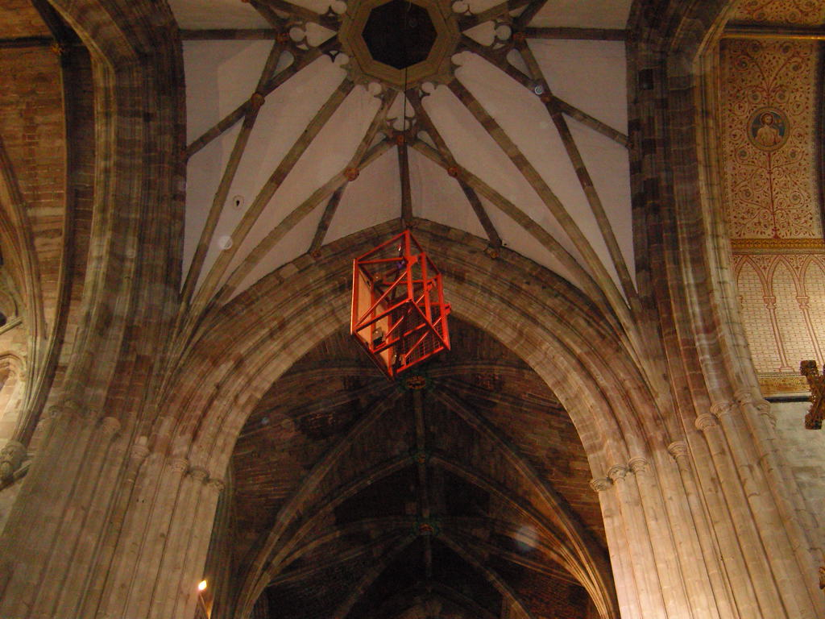
Worcester Cathedral’s Teaching Centre

Slide 30
Worcester Cathedral’s Teaching Centre
What is it?
It is only hardware, well
£40,000 worth
It is not the solution
It evolved and we made
mistakes
It has been copied and
improved at Adelaide

Slide 31
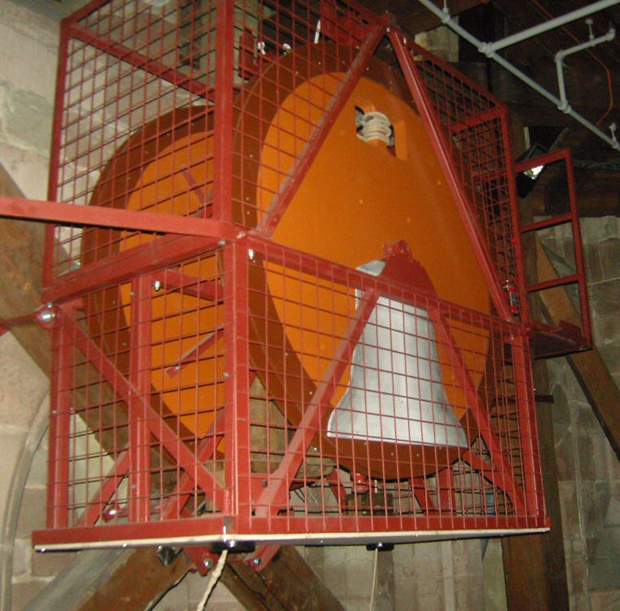
Worcester Cathedral’s Teaching Centre
How does it work?
A massive change in
attitude
Working with schools.
Community engagement.
Open doors
We had to change first:
how we think and how we
do things

Slide 32
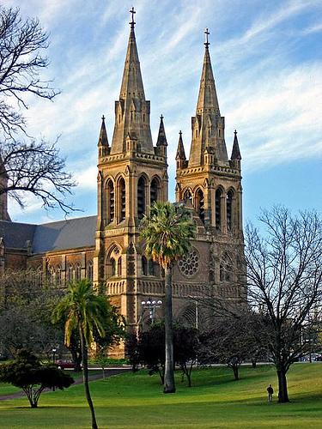
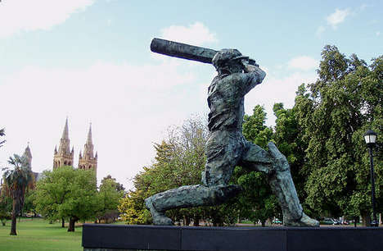
Notes:
Explain Adelaide link
And the minor ten story at WCCC

Slide 33
Three groups
The church
Schools
The community

Slide 35
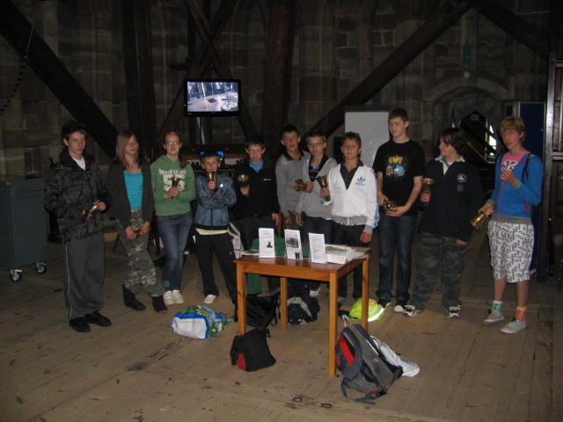
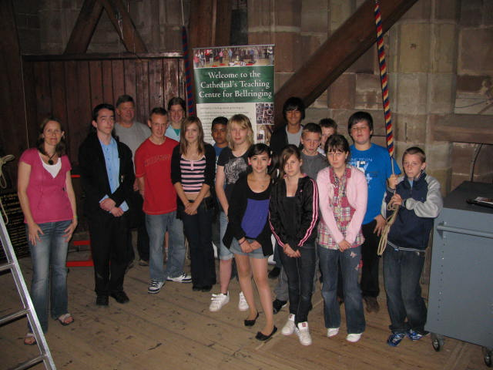
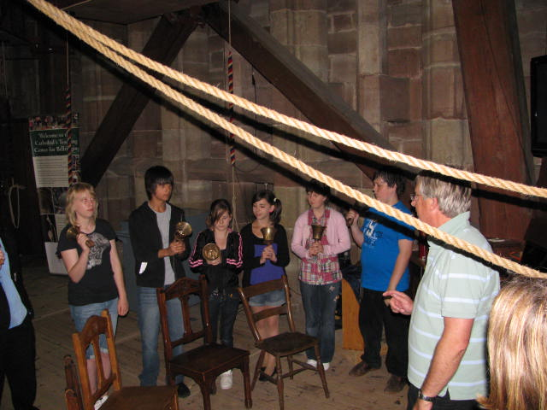

Slide 36
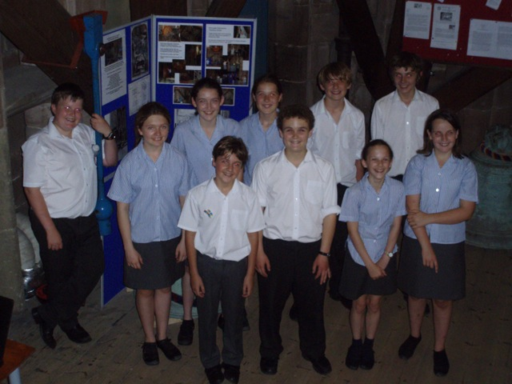

Slide 38
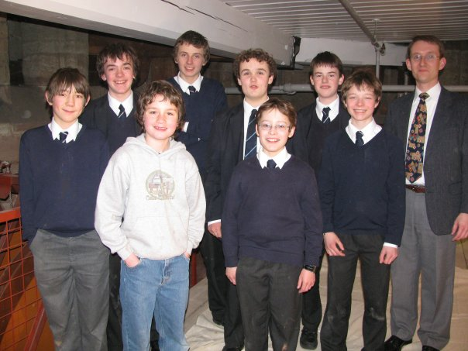

Slide 39
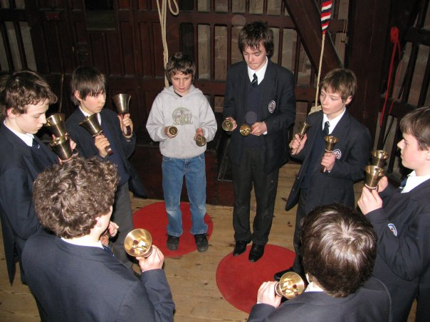

Slide 41
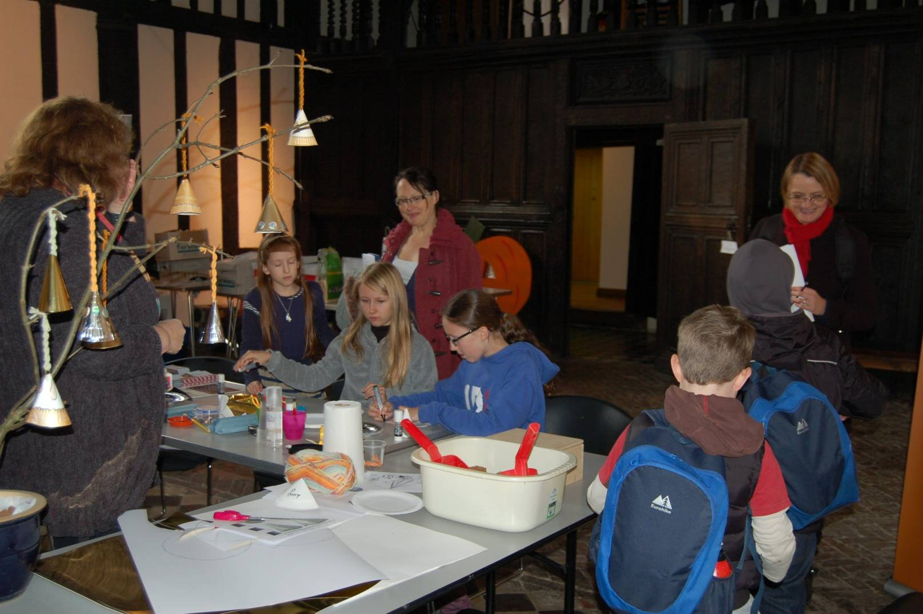

Slide 42
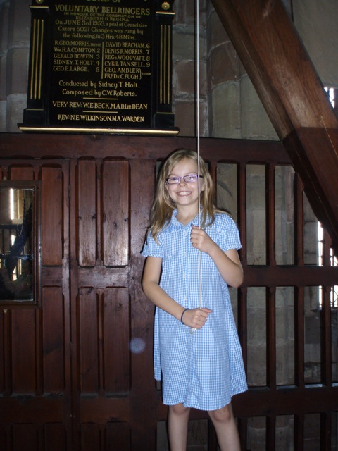
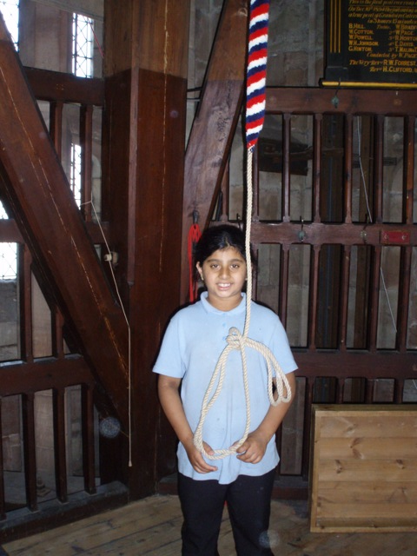
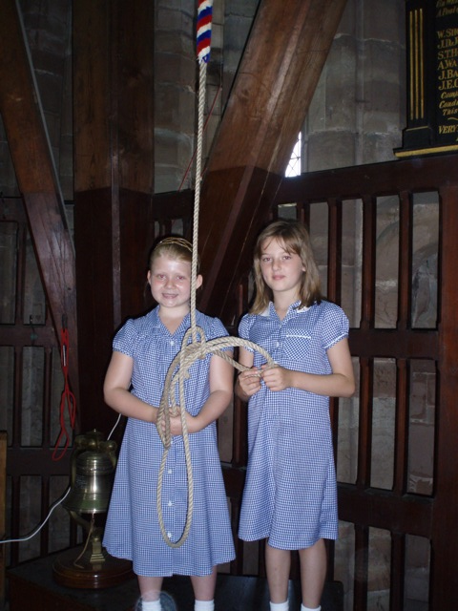

Slide 43
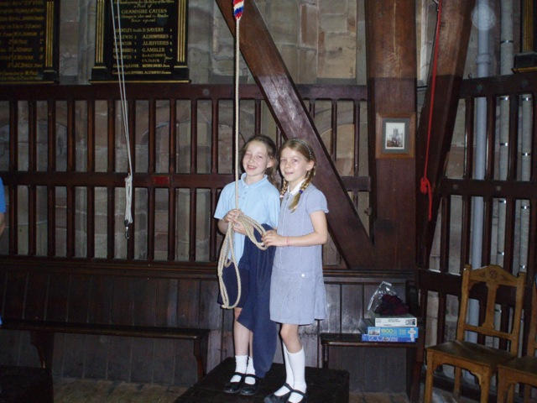

Slide 44
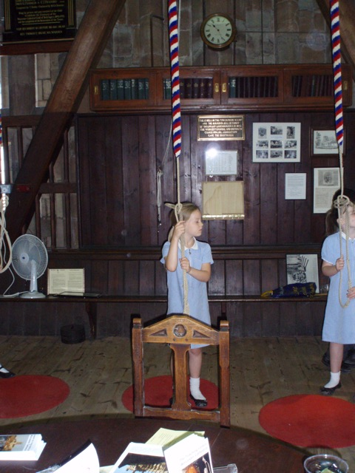

Slide 46
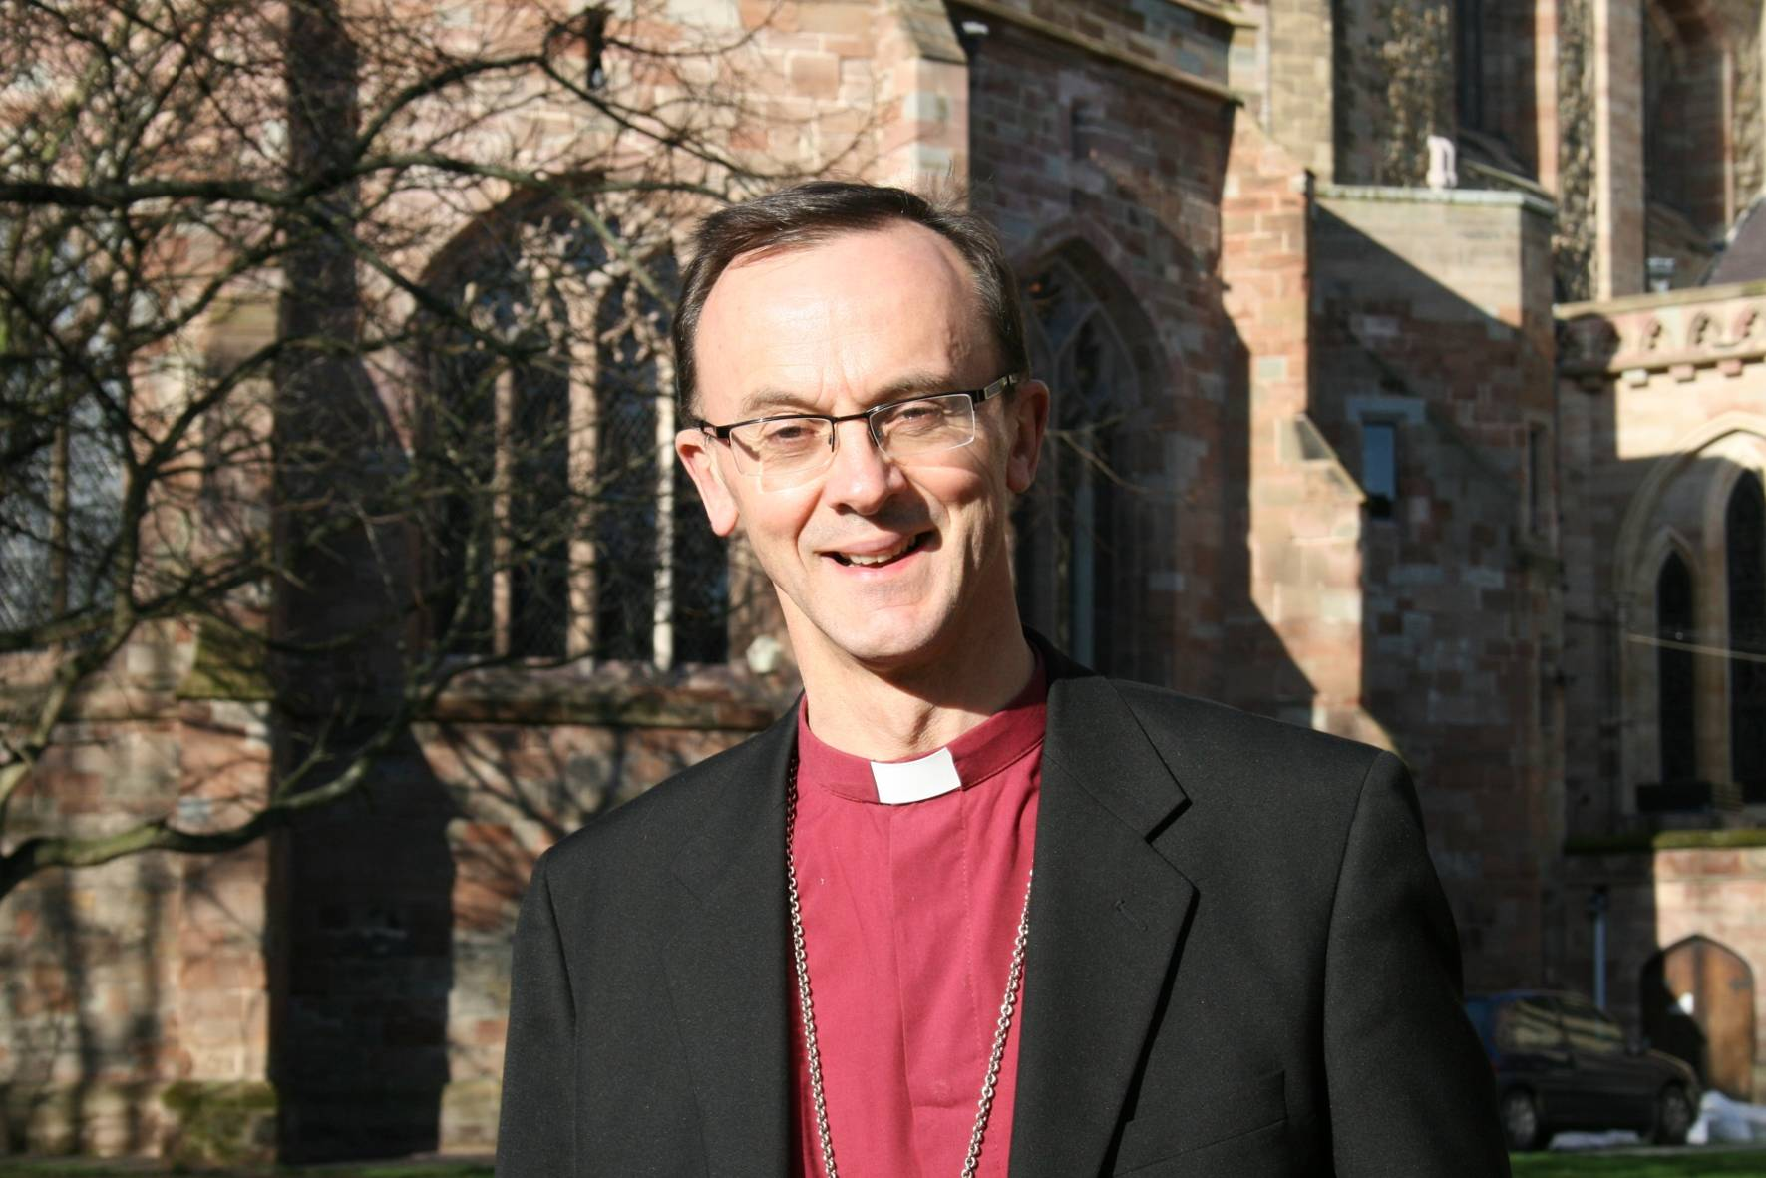
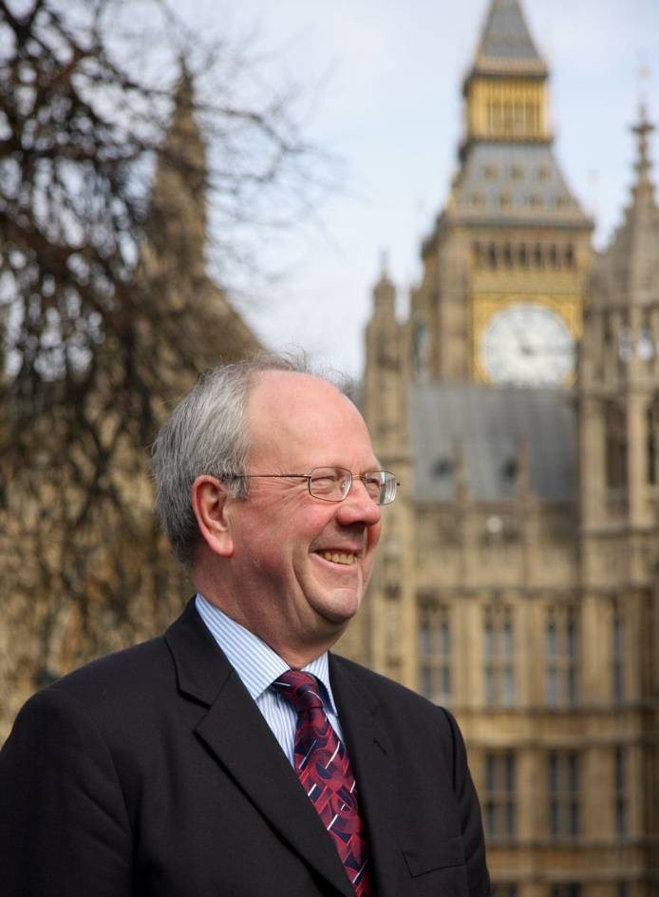

Slide 47
We do two things
We ring on Sundays
And we teach
How we ring and not what we ring
Our doors our open
We work with the church and the community
It does what it says on the tin
We say ‘yes’

Slide 48
And our biggest challenge?
We don't have enough suitable ringers, with the time, to teach the demand we have created!

Slide 49
What will you do differently after today’s workshop?

Slide 50
How do you make things happen?
Advocate
The Church and the Community

Slide 51
Mark
Many thanks to you and the team for an interesting and thrilling evening. We had not previously understood how exciting it is.
Kind Regards
Nigel Wake President Rotary Club of Worcester
"To experience New Year's Eve with the bell-ringers was not just great fun - it was an uplifting and (literally) moving experience. The tower of Worcester Cathedral is a special, unique place, the inside almost has a living room atmosphere. And the people we had the opportunity to meet were most welcoming. We enjoyed the warm atmosphere and found it was a unique way to spend New Year's Eve."
Helen Morris
Christian Schnee

Slide 52
My husband George visited the Cathedral bell tower on your practice night and the captain very kindly allowed him to join in with the other ringers. He was absolutely thrilled and has since talked much about this experience. Because we enjoyed Worcester so much, I am now planning a weekend visit…
I haven't enjoyed a ringing practice as much as last night's for years (literally). As we were saying, placing the band and getting the rounds right before ringing makes it all so much better and keeps everybody focused on every blow.

Slide 53
Hi Mark, I just wanted to thank you for last night. It was excellent. Bev, despite not being on her best form, said it was the best New Year she can remember. Best wishes. Peter Furniss
Hi Mark
A quick note to say many thanks for the warm welcome at Worcester last night - I very much enjoyed the practice and the bells are really excellent.
Best wishes,
Mike (Purday)

Slide 54
opportunityisnowhere

Slide 55
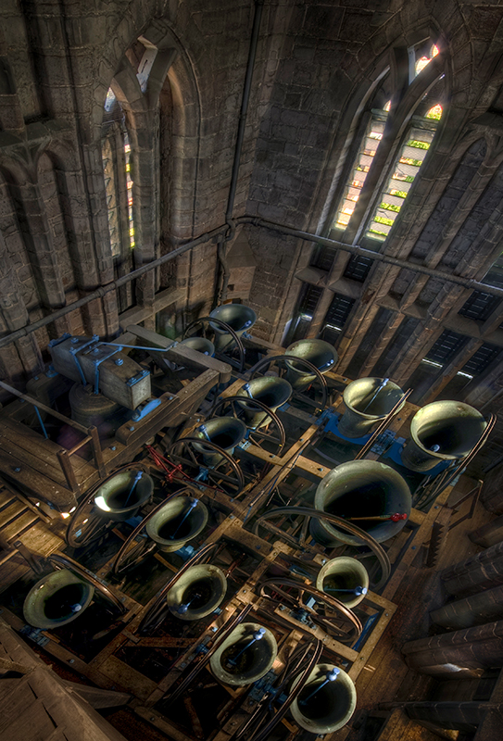
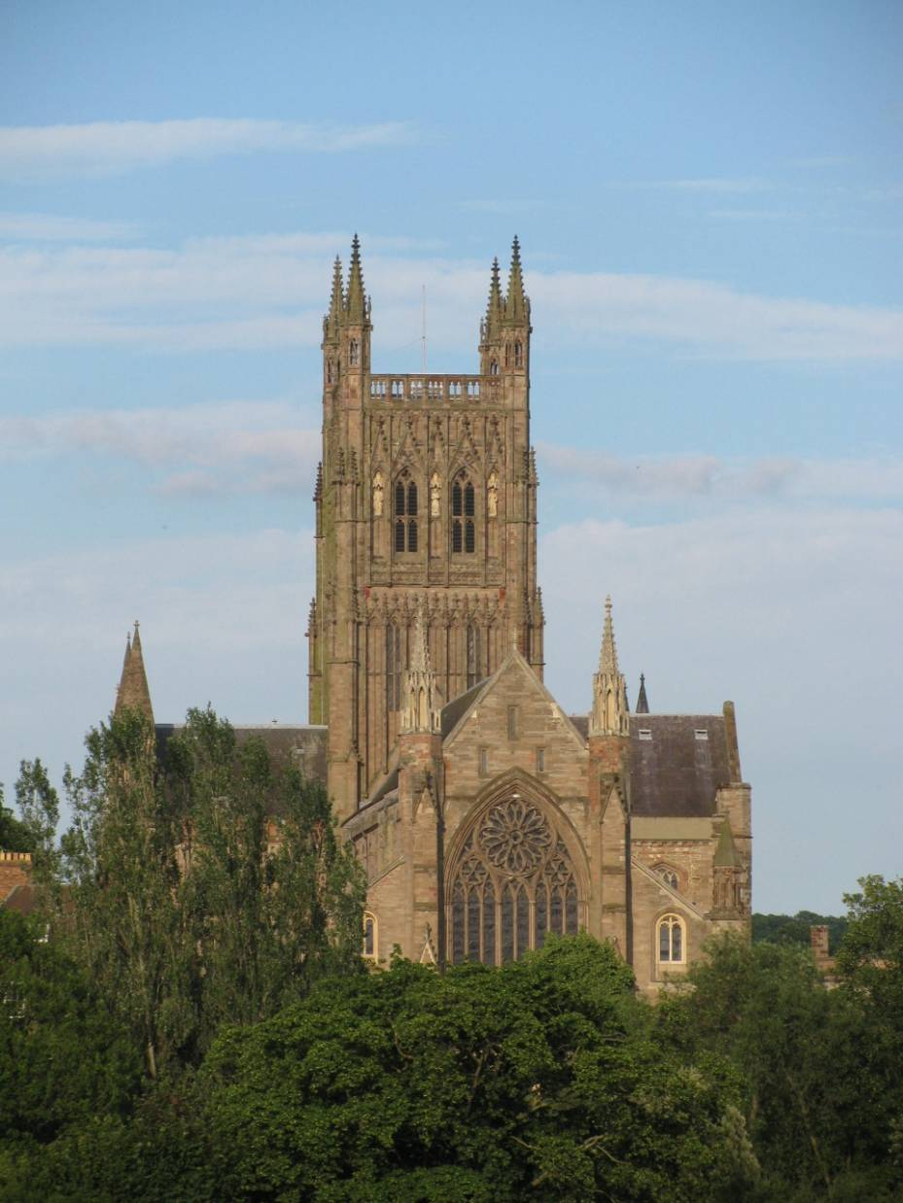

Slide 56
Thank you
And please visit Worcester

