Slide 1
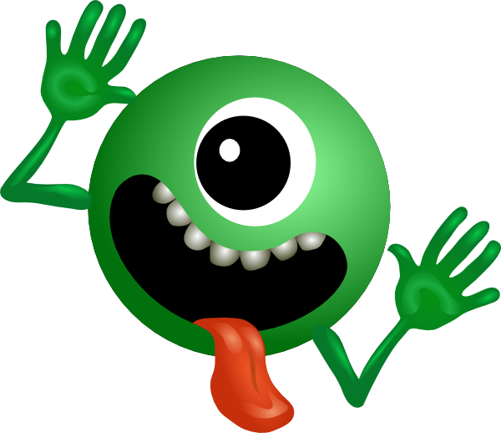
H E L P ! !
I’m a Tower Captain –
get me OUT OF HERE!

Slide 2
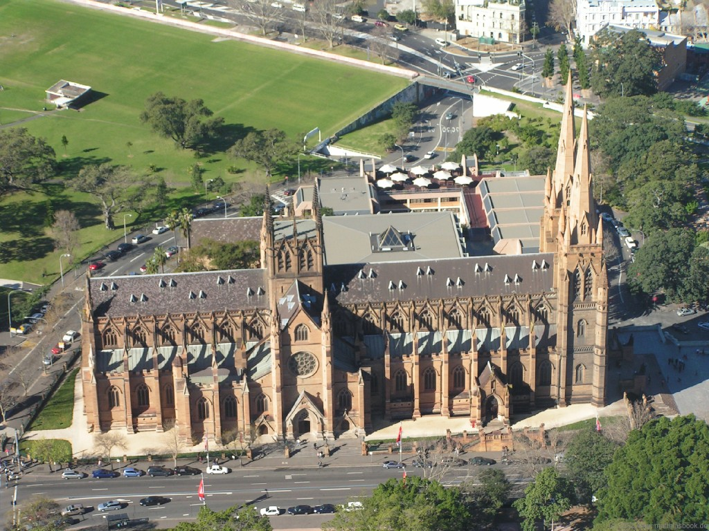
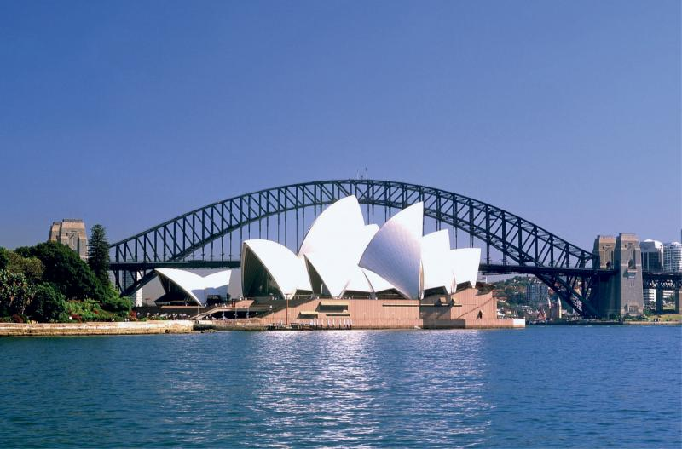
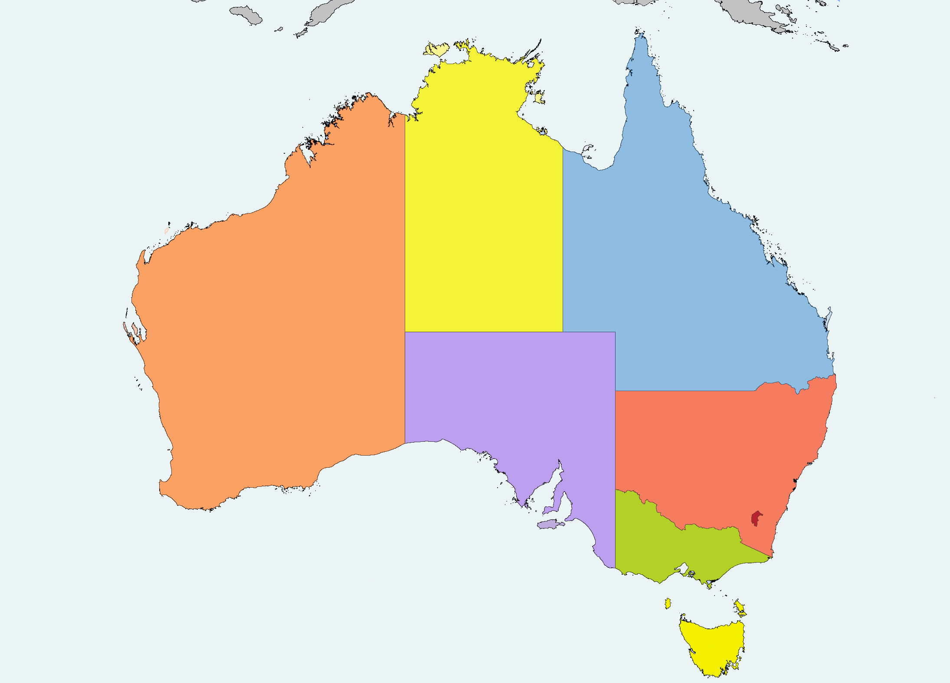

Slide 3
Diplomat
Counsellor
Rope Splicer
De-flouncer
Vicar Liaison Officer
Trainer
Tower Captain
Conductor
Accountant
Public Relations Officer
Wedding Planner
Manager
Leader
Engineer

Slide 4
D O N ‘ T
P A N I C

Slide 5
P.E.A.L.S.
P | PANIC! (don’t) | How one becomes a tower captain. What’s in the job description.
E | Essentials? | Excellence? Excitement? Exasperation? Education
A | Attitude | Balancing quality control and inclusion, running good practices, Sundays, weddings etc…
L | Learners | Young / old; D of E experiences; recruitment and retention; Young-Ringer-Award-Schemes…
S | Support | Resources – DBS, noise complaints, Health and Safety, Risk Assessments, Belfry maintenance, etc etc etc (Plus forthcoming CC proposals – “Go Regional” and “Education Development Funds”)

Slide 6
The Ideal Tower Captain… (what do you think?)
Attribute…
Attribute…
Attribute…
Attribute…

Slide 7
The Ideal Tower Captain…
Good Leader
Good Listener
Good Planner
Good Developer
Good Sense of Humour
Well organised

Slide 8
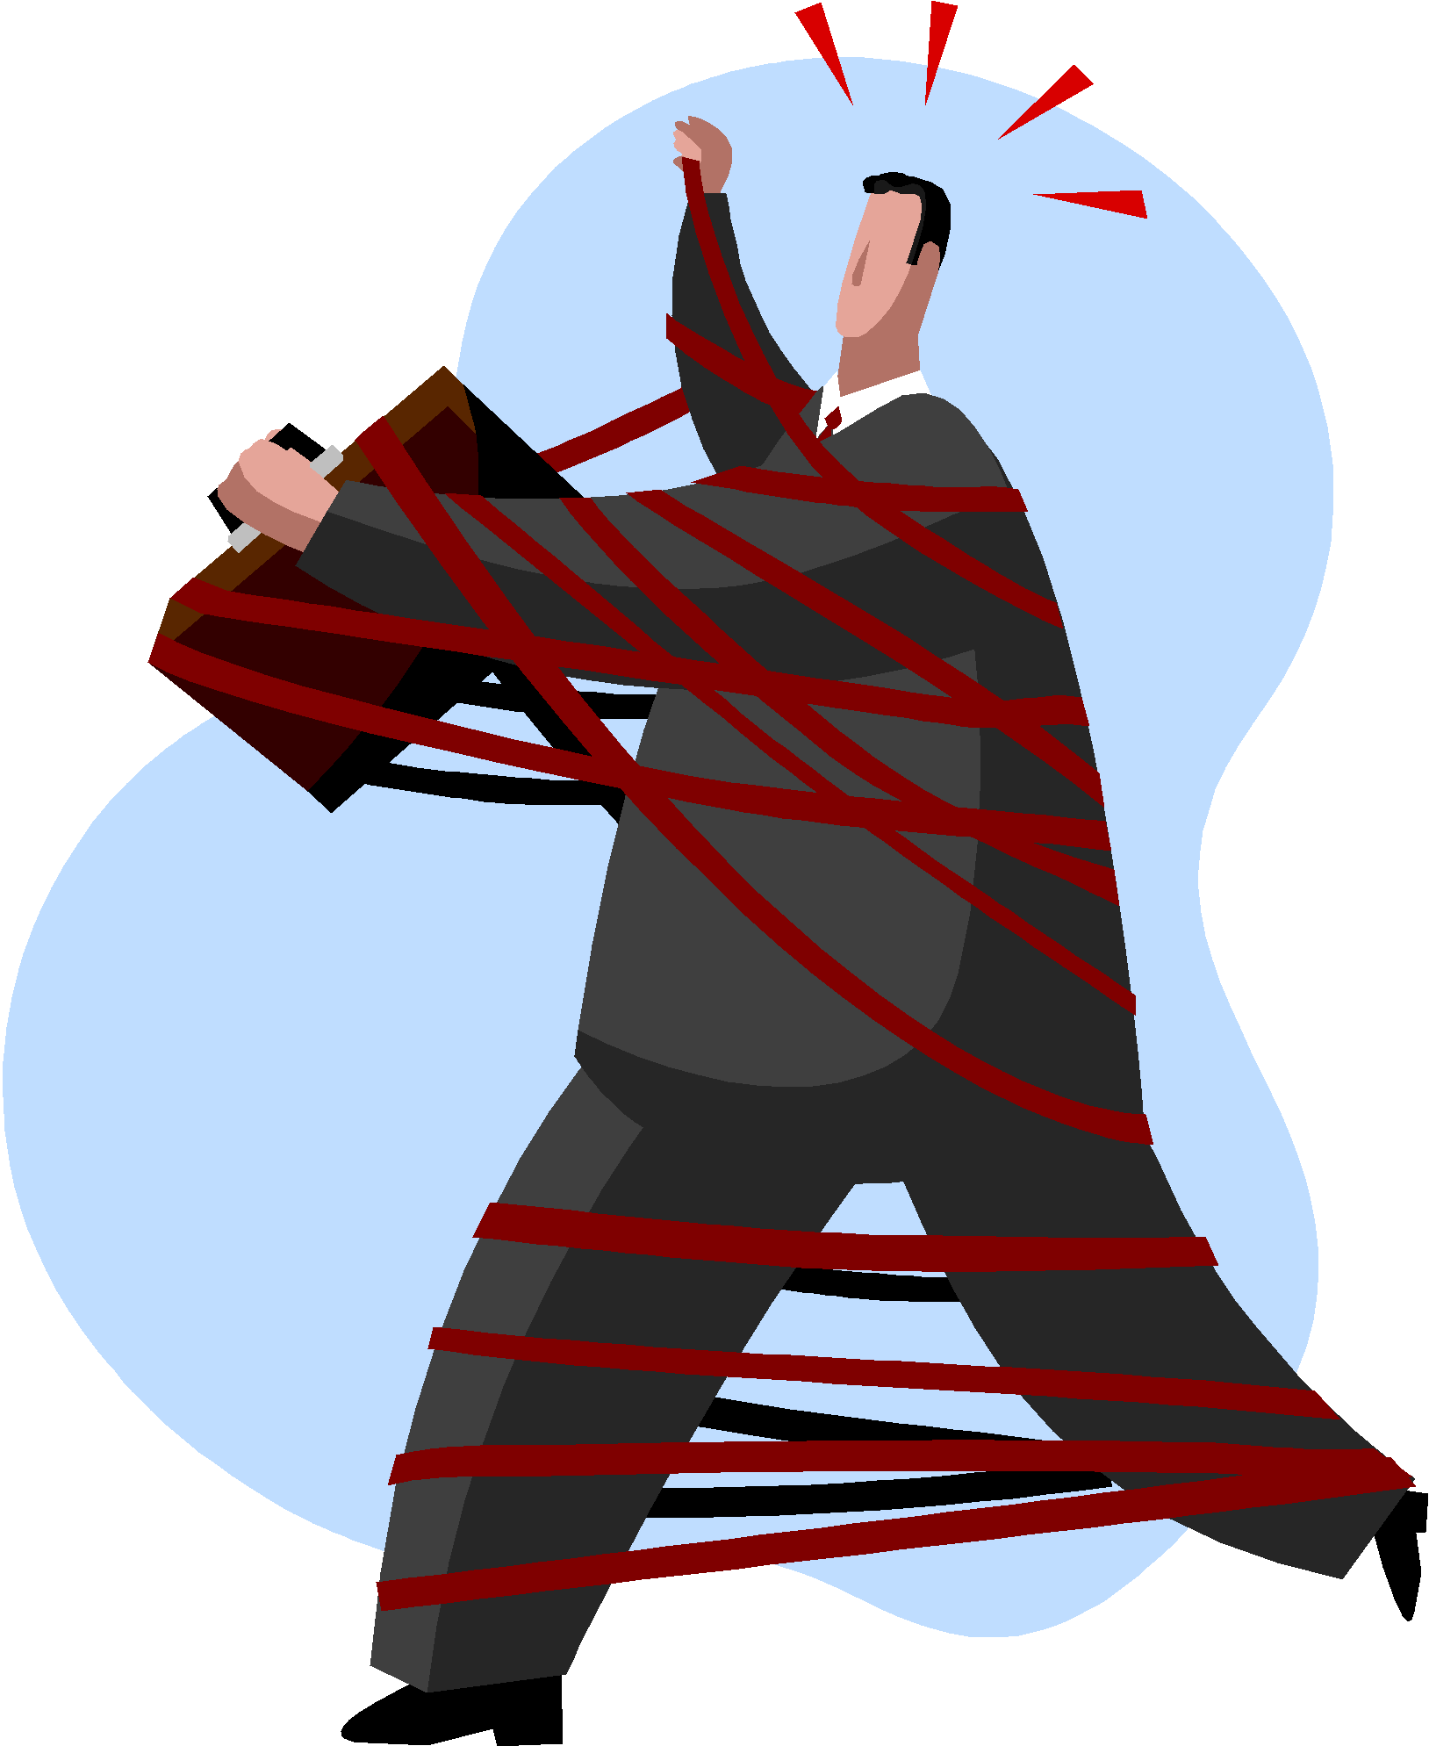
Governance
Tower Constitution?
Annual General Meetings?
Elections?
Bank Accounts?
The PCC

Slide 9
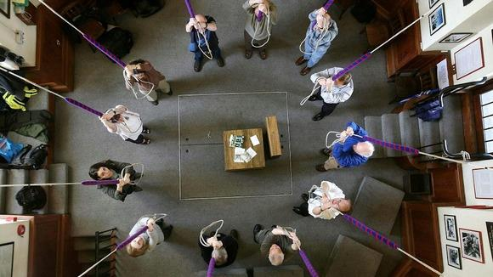
Attitude
Inclusion v quality control
Democrat or Dictator?
Running the ringing
Sundays, Practices, weddings…
“Method of the Month”
Planning ahead

Slide 10
P.E.A.L.S…. (again)
P | Punctuality
E | Effort
A | Application
L | Learners
S | Service

Slide 11
Learners
Recruitment and retention
Young V young-at-heart
Keeping it fun
D of E experiences
Young-ringer-of-the-year award
Getting around

Slide 12
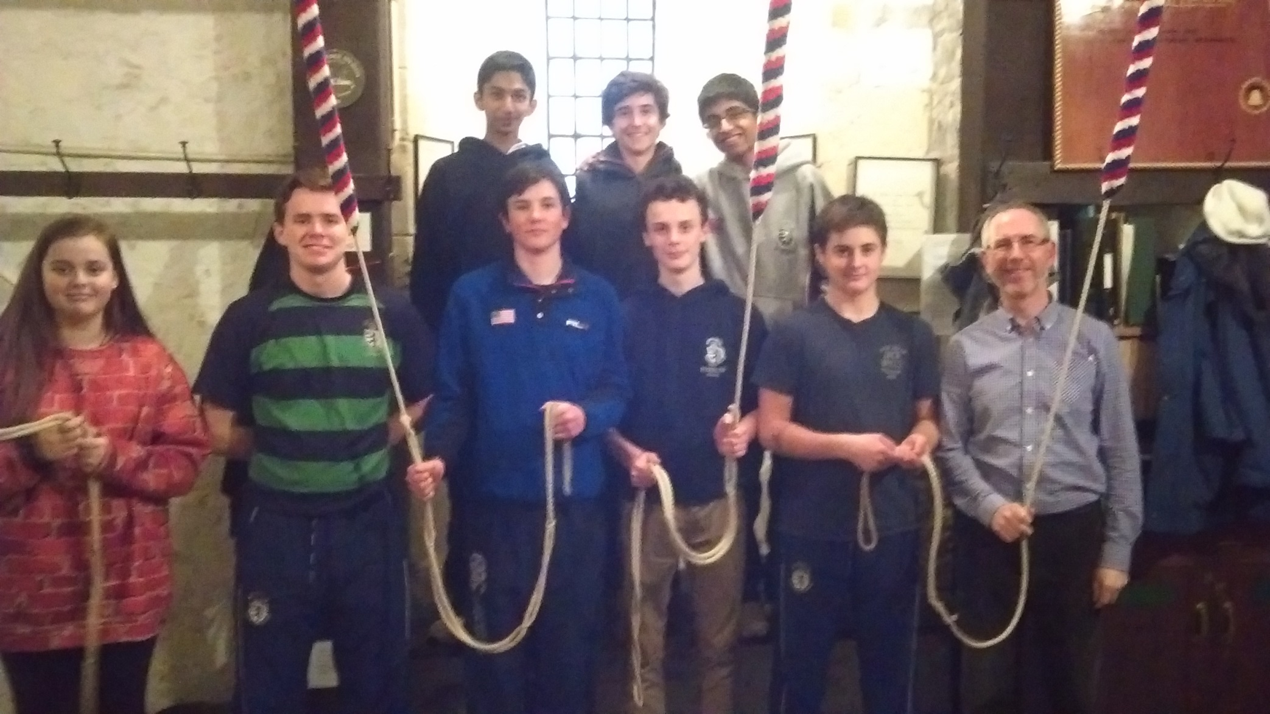
Learners!

Slide 13
The Art of the Flounce
The spontaneous flounce
The pre-meditated flounce
The collective flounce
The backfiring flounce

Slide 14
The Beaufort Scale
0 | Perfect Ringing | Complete absence of any fire-up whatsoever.
1 | Mild Inaccuracies | Slight furrowing of the Conductor’s Brow - Conductor says “keep them moving”.
2 | Small Trip | Frown on face of Conductor. Conductor says “Come along now”.
3 | Bigger Trip | Conductor begins to glare. Conductor says “Finish it” quite loudly.
4 | Light crunching involving 2 or more bells | Conductor begins to go red. May shout “JOHN” or some other band member’s name.
5 | Heavier crunching involving 3 or more bells | One end of the change begins to disappear. Conductor begins to stamp foot and shout coursing order. Conductor now crimson.
6 | Full crunching involving at least half the band | First bell on wrong stroke. Conductor now purple with vein standing out on forehead. First obscenity uttered. Light damage to composition.
7 | Light Firing | Half the band now striking at once. At least two bells on the wrong stroke. Conductor now doing full morris dancing/village idiot impression. Instructions now incoherent.
8 | Heavy Firing | Most of the band now striking together. At least 3 bells on the wrong stroke. Ringing beyond engineering capabilities of Conductor. Structural damage to composition.
9 | Storm Force Firing | All but one band member now striking together (called a “Whoomph Ping”). At least half the band on wrong stroke. Terminal damage to composition.
10 | Heavy Storm Force Firing | Near total absence of striking. A “Wall of Ropes”. Conductor considers saying “Stand.”
11 | Hurricane Force Firing | Complete absence of striking whatsoever. Conductor says “Stand”, grudgingly.

Slide 15
Central Council Resources and Support
Bell Restoration
Biographies
Compositions
Education
ICT
Library
Methods
Ringing Centres
Peal Records
Public Relations
Publications
Redundant Bells
Ringing Centres
Ringing Trends
Tower Stewardship
Towers and Belfries

Slide 16
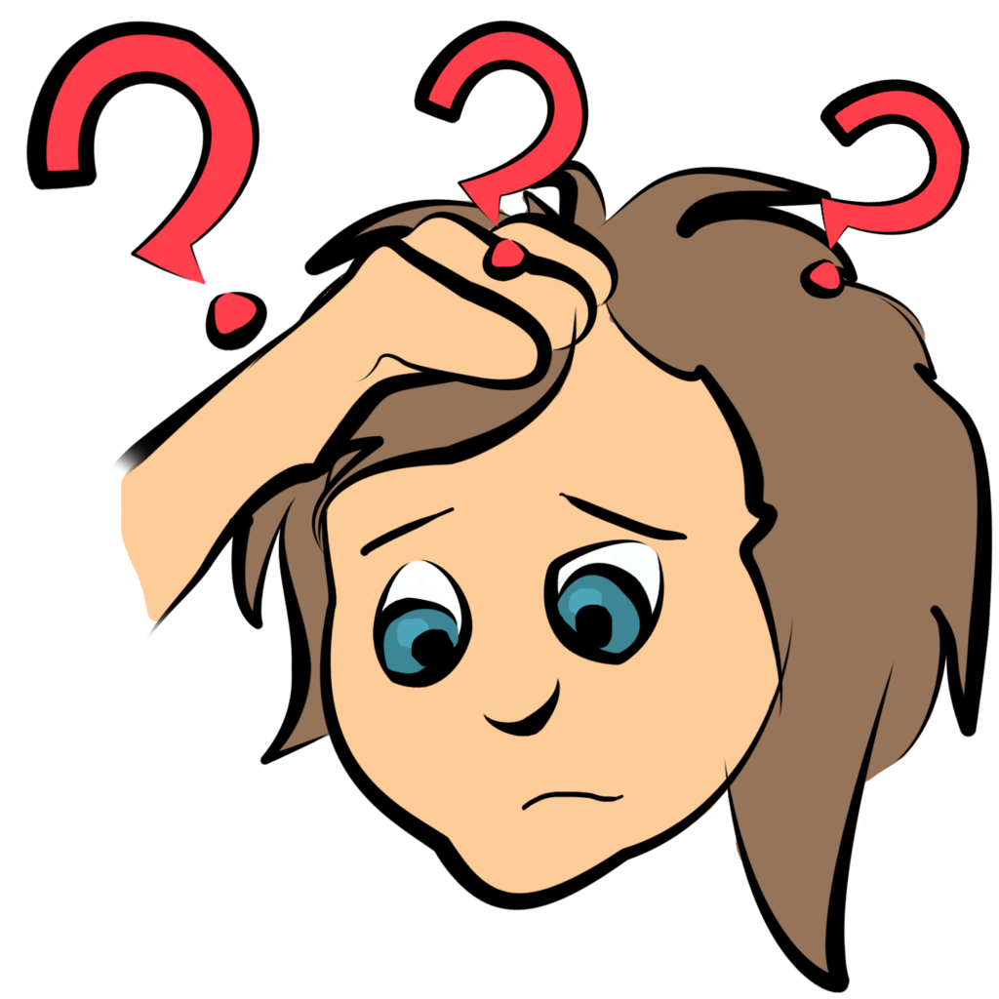
Tower Stewardship (for example)
GN1 - Insurance
GN2 – Tower Management
GN3 – Safeguarding / DBS
GN4 – Tower Safety
GN5 – Church Law
GN6 – Fire Risk
GN7 – Noise Complaints
GN8 – Data Protection

Slide 17
Websites
www.cccbr.org.uk
www.ringing.info
www.leicesterdg.org.uk
www.bath-wells.org
www.bellringing.london/

Slide 18
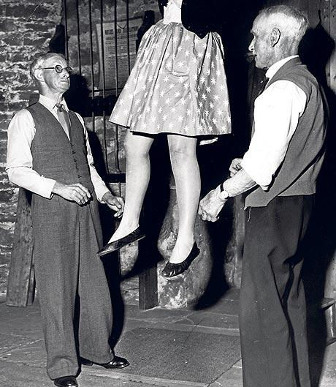
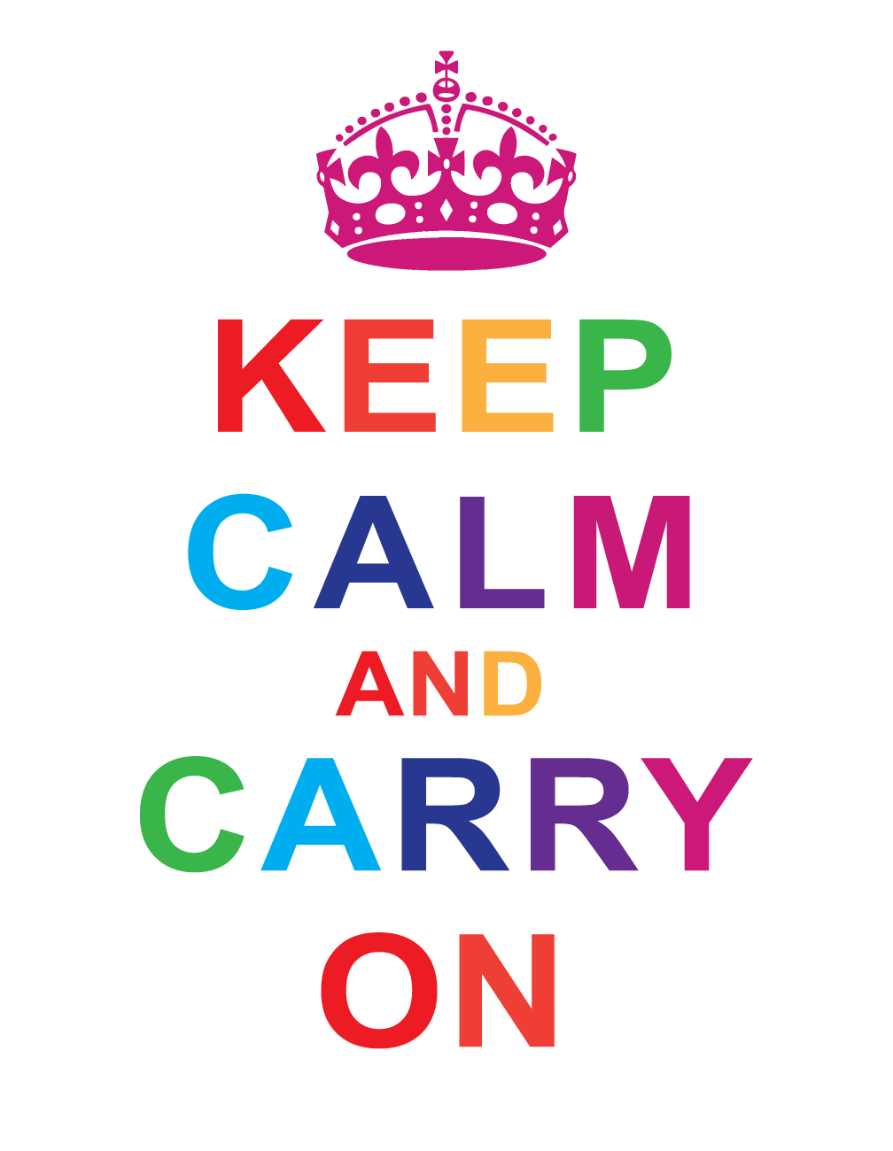
Thank you!

Slide 19
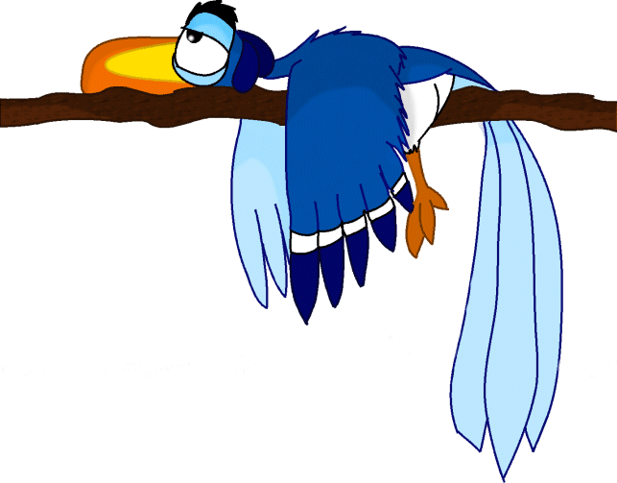
A week in the life…
Saturday | Plain Bob Doubles training day – Harefield
Sunday | 10 – 10:30am service ringing 4 – 6pm D of E handling session 7 – 10 Handbell peal
Monday | Practice night
Tuesday | 7-8:30pm Monthly CC officers conference call
Wednesday | Handbell peal cancelled – rare night in!
Thursday | Preparing A.R.T. presentation
Friday | Middlesex monthly 10-bell quarter peal – Fulham
Saturday | Peal attempt – spliced surprise royal After dinner speaker – Leicester DG annual dinner
Sunday | 10 – 10:30am service ringing 4 – 6pm D of E handling session

Slide 20
Interactive
The ideal Tower Captain…
The Plain Hunt Dance
Two-up
Sharing Stories

