Slide 1
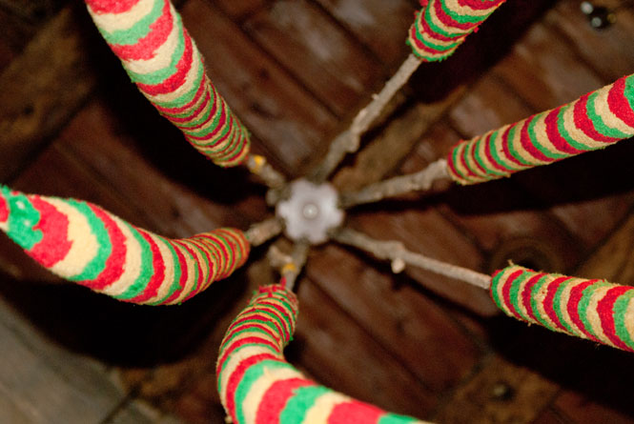
Learn the Ropes this Summer ?
Fancy having a go at Church Bell Ringing?
We are offering demonstrations and ‘taster sessions’ at the Edgehill Ringing Centre, St Peter’s Kineton on
Saturday 27th June from 10am until 12 noon
Tea, Coffee and Cakes available.
Please do come along, or if this time is not convenient, we can arrange another session
Please contact: ********** Tel: *********
Or email: ***********
For further details

