Slide 1
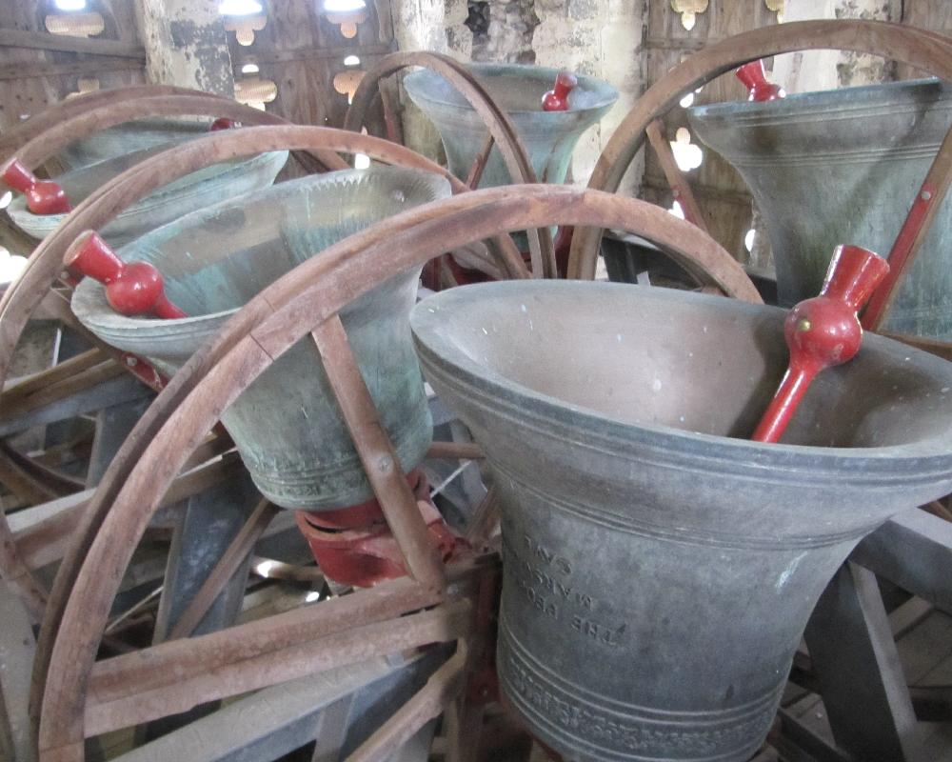
How About Playing the Real……
Heavy Metal ??
Ask a member of The Band today,
or call Richard on: ********
or Ruth on: ******

