Slide 1

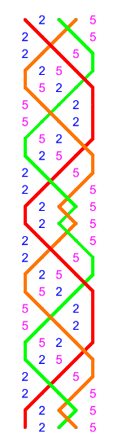
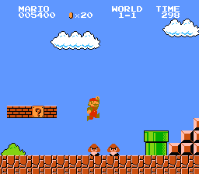
Are you good at Computer Gaming?
Church Bell Ringing
Fast hand to eye co-ordination
Mathematical patterns and grids
Personal progress
Sociable team activity (gets you away from the screen)
Mental stimulation
Interested in learning more?
Call Dave on : Tel: *******

