Slide 1
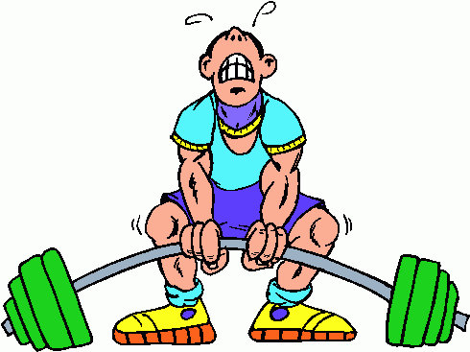

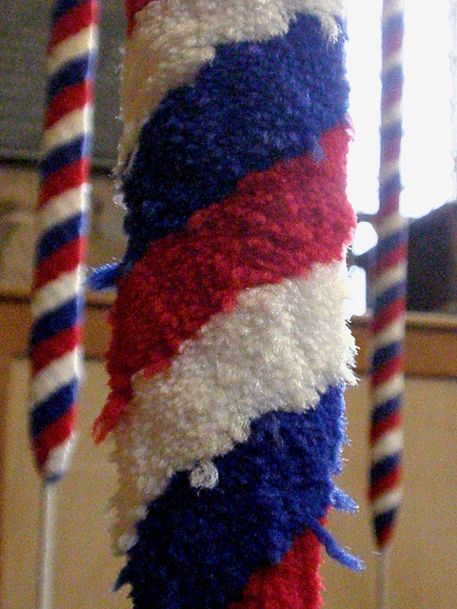
Bored with the gym?
Fed up with evening classes?
Tired of PlayStation?
Try another hobby to exercise both brain and body…..
Church Bell Ringing!
Take part in a great English Tradition and join a highly sociable team.
There will be a course for beginners in the area starting on Monday the 16th of May.
For information visit
www.****************.co.uk
Or contact Colin on: *****

