Slide 1
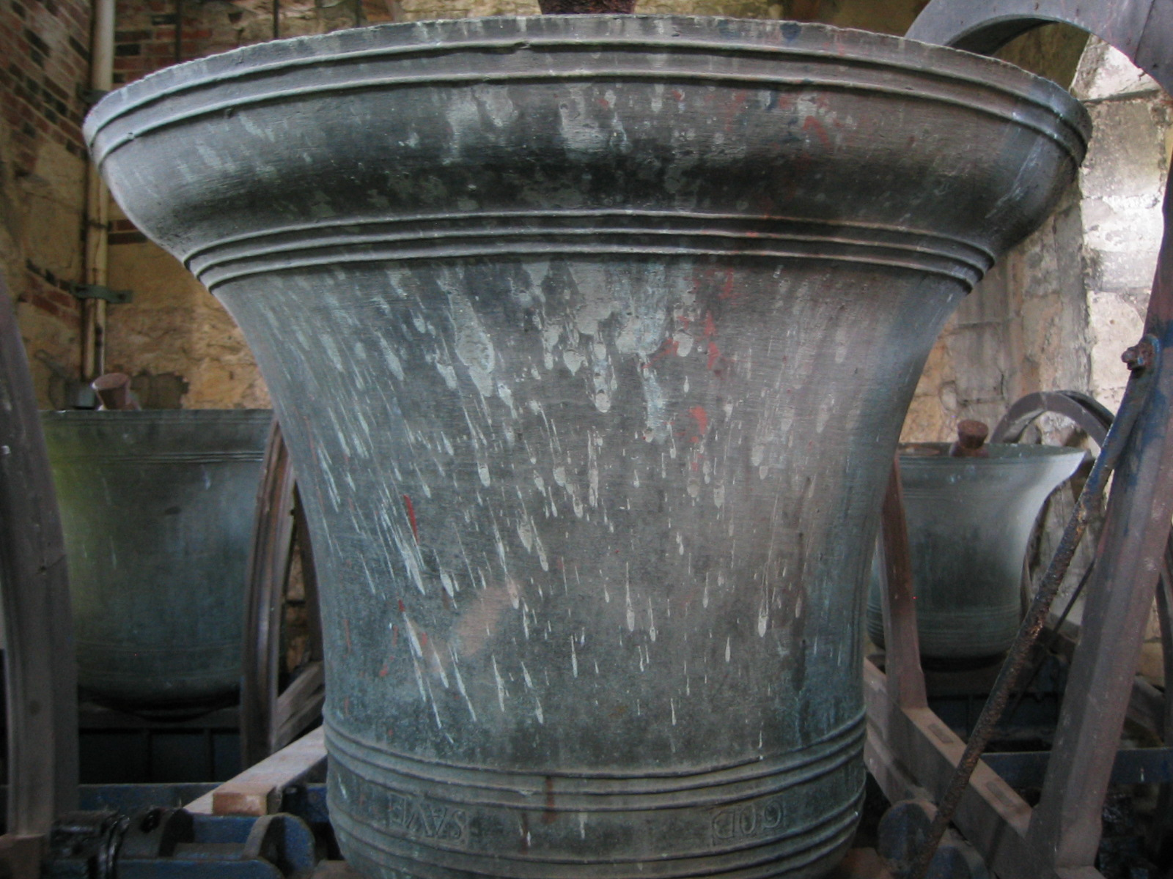
Are you interested in maintaining a 400 year old English tradition?
(No, we’re not talking about Morris Dancing!)
Bellringing….
Does not require strength
Just requires skill, patience, enthusiasm
And the ability to climb stairs!
You are welcome to join us for a trial session to find
out if it is right for you.
Interested?
Call Bob on Tel: ***** or email: *****

