Slide 1
Survival and Recovery Toolbox
Add your ringing society name
Add you name

Slide 2
What is the toolbox?
A website developed by ART and CCCBR
Help deliver a successful return to ringing
Designed for:
Ringers – helping yourself
Tower Captains – helping your band
Ringing societies – helping bands
Webpages contain:
Information – tips, ideas, videos
Case studies
Opinion pieces
ringingteachers.org/survival-and-recovery-toolbox

Slide 3
Example – getting fit for ringing
A major concern for ringers
3 practices a week = 1800 plus shoulder stretches
Two ringing professional physiotherapists
Set of exercises to do at home.
Fit into your life e.g. when you walk through a door
Targeted at ringers – other pages outline ideas for Tower Captains on a successful transition back to ringing
Offered a go on a simulator before Sunday ringing resumed in the Summer – 25% of branch took advantage of the offer
ringingteachers.org/survival-and-recovery-toolbox/fit-to-ring

Slide 4
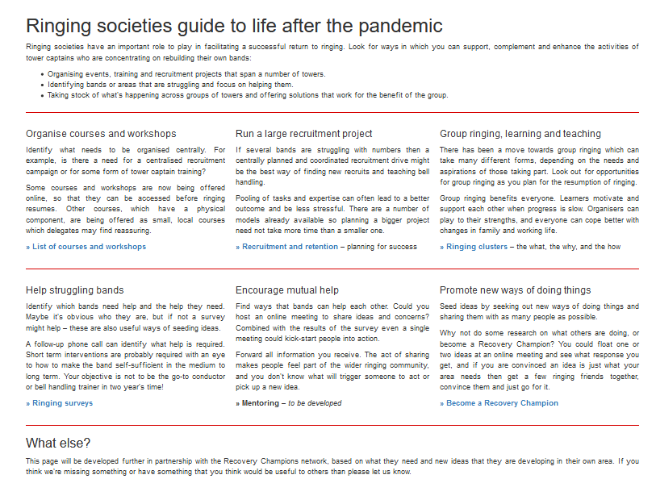
Example – for ringing societies
What you can you do:
Organise events, training and recruitment projects that span a number of towers
Identify bands or areas that are struggling and focus on helping them as individual towers or as a group of towers
http://ringingteachers.org/survival-and-recovery-toolbox/ringing-societies-guide

Slide 5
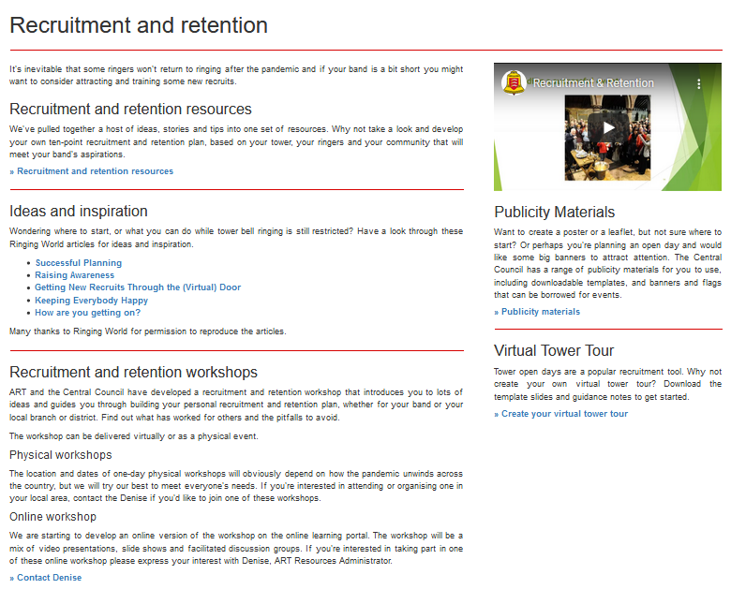
Example – recruitment and retention
Resources
Case studies and know-how. Don’t reinvent the wheel or forget something
Workshop – physical and online versions
http://ringingteachers.org/survival-and-recovery-toolbox/recruitment-and-retention

Slide 6
What’s next?
Enjoy and use the resources
Some resources aren’t complete – they will be added later
Give your feedback
Develop a joint plan for future work
Keep in touch
ringingteachers.org/survival-and-recovery-toolbox

