Slide 1
Vinni Sullivan

Slide 2
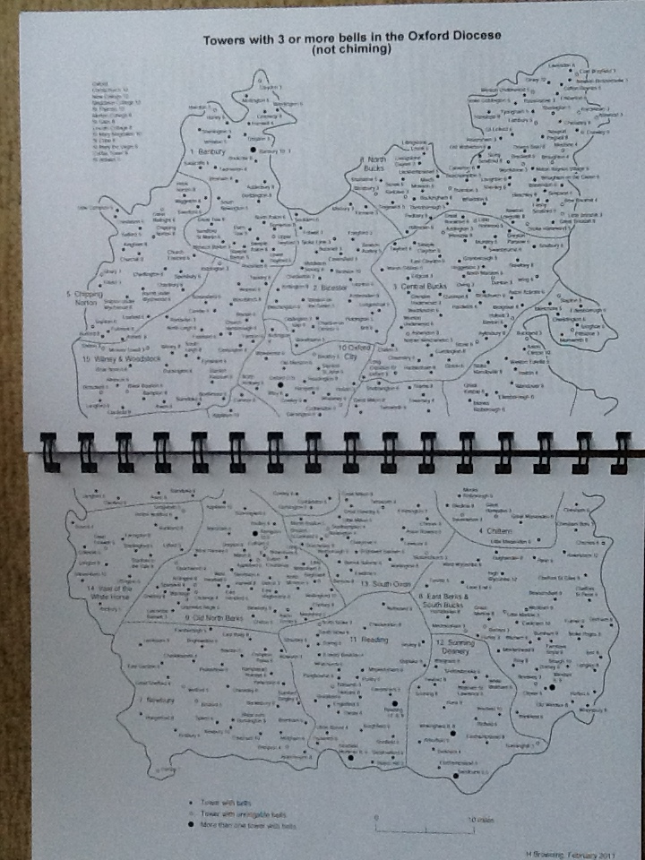

Slide 3
WHY?
ART asked its members in the area to consider it!
Three of the towers had an ART full member.
Some co-operation already existed between the towers.
It formalised the links between the towers and helped promote the use of LtR
The towers are close geographically, with other branch towers being much further away.
We thought it seemed like a good idea.

Slide 4
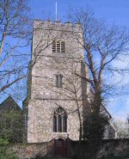
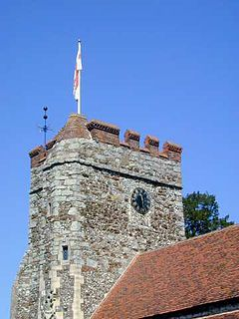
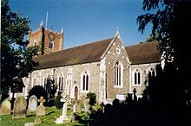
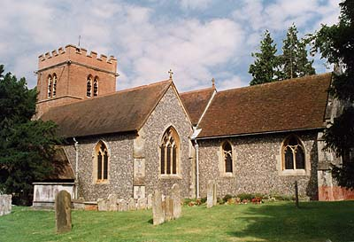
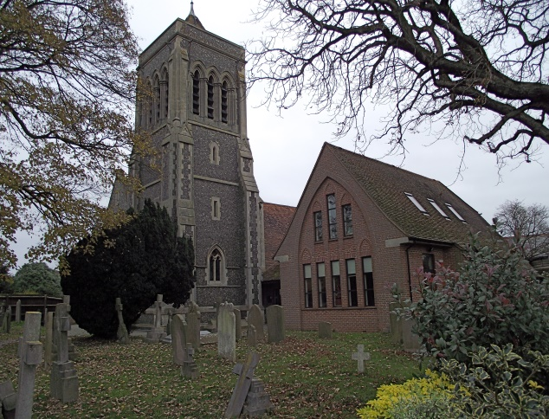
5 Towers
Sonning – 20 cwt 8
Wargrave – 17 cwt 8
Waltham St Lawrence
12 cwt 6
Hurst – 14 cwt 8
Twyford – 12 cwt 8

Slide 5
What have we done?
Arranged workshops.
Supported each other in teaching and at practices.
Arranged an ART Module 1 course.
Rung 34 quarter peals. (11/2/18, 2b updated!)
Had a Christmas Curry for adults.
Had a fun festive practice for the youngsters.
Raised the profile of LtR and ART.

Slide 6
On the plus side.
Increased motivation to make things happen
Raised overall standard of ringing in the hub
Reduced isolation
Helped reduce teacher burn out
Raised funds for ART
Disseminated good practice
Increased publicity for ringing.

Slide 7
Still to do
Practices and Service Ringing at Hurst
Ensure all students develop good handling styles
Increase use of LtR in Sonning Deanery Branch and neighbouring branches.
More social events.
More targeted workshops.
Weekend / evening QPs.

Slide 8
Would we recommend others to form Hubs?
Would we do it again?
Will we continue?

Slide 9

Small Is Beautiful

Slide 10

About this presentation
Context and challenges at Bardwell
Going it Alone!
The Road to Success
Where we are Now
Concluding Thoughts

Slide 11
Context and Challenges
Silent tower for 30 years
Restoration completed in 2010
No ringers
Lack of local support to develop a new band

Slide 12
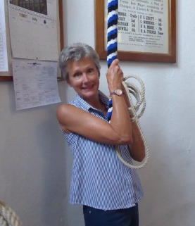
Going It Alone!
Our approach is the ART approach
We work within our limitations
Meet Jan !
Jan started out 2013
No experience of teaching
Now a fully accredited ART teacher

Slide 13
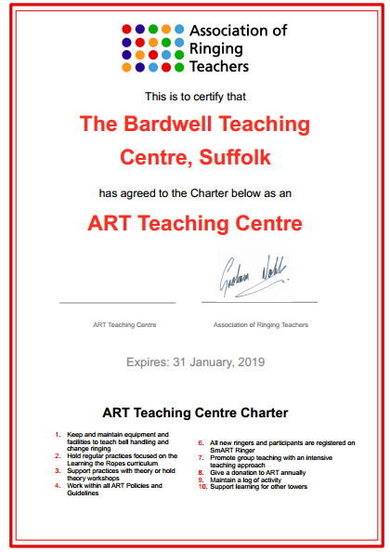
The road to success
Any tower can do it !
Declaring our intentions
Confidence grows

Slide 14
Where we are Now
Nice set of eight ringable bells with simulator
The church supports our endeavours
2 full ART members as teachers and 2 in the pipeline
Vibrant and engaged band which supports the Sunday band

Slide 15
Results
Some of these 10 reached level 3

Slide 16
Concluding thoughts
Being small is not a barrier
Be clear about your approach
ART resources are superb
What’s stopping you ?

