Slide 1
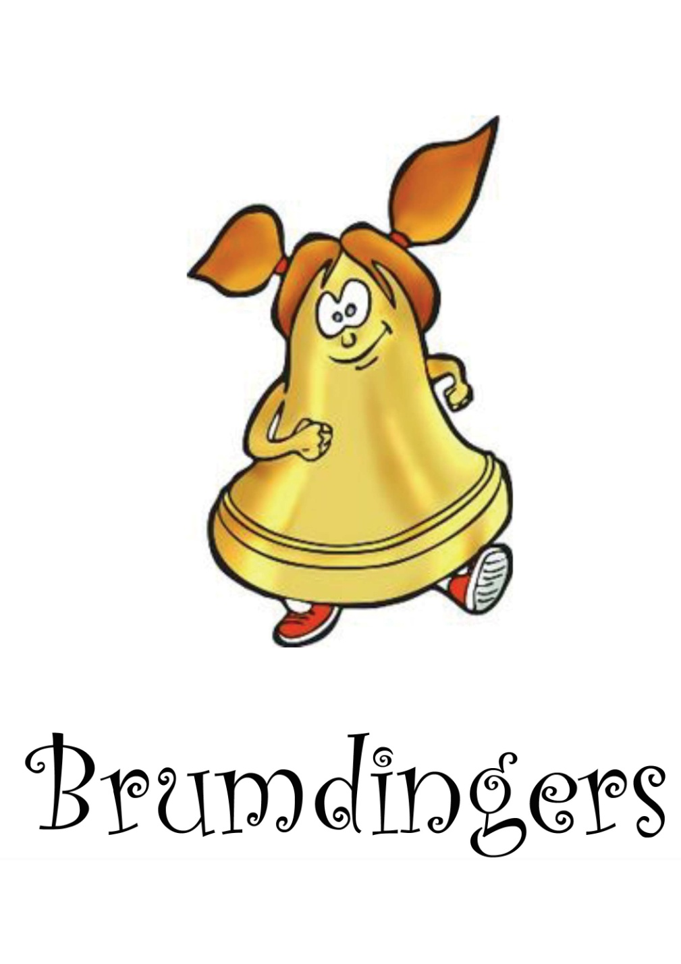

Words: Simon Linford Colours and animation: Charlie Linford!

Slide 2
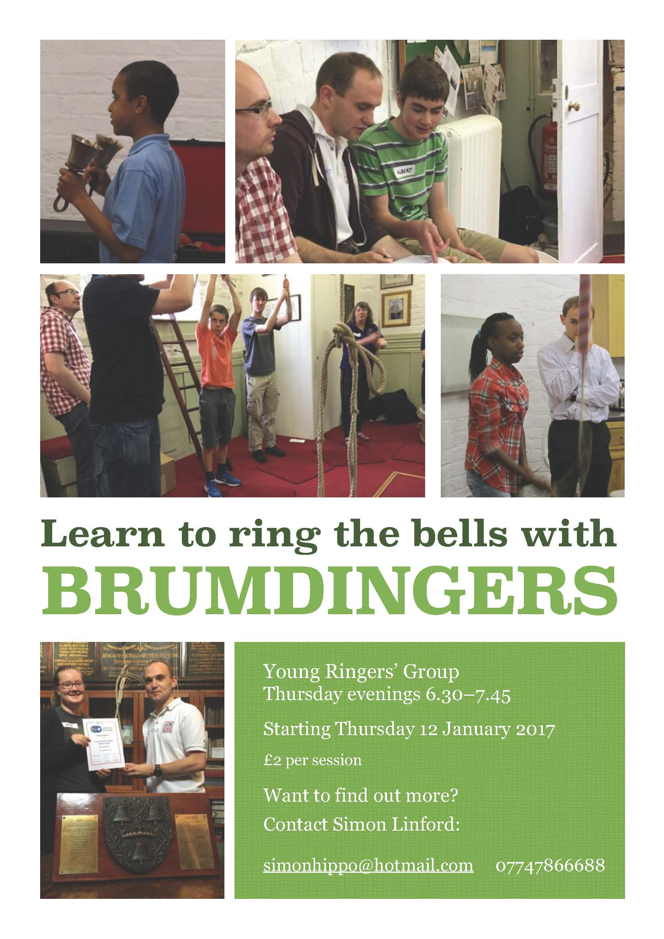
Brumdingers format
Weekly dedicated practice
Not with the local band
(but with their blessing)
6.30 to 7.45
Half time snack break
£2 charge

Slide 3
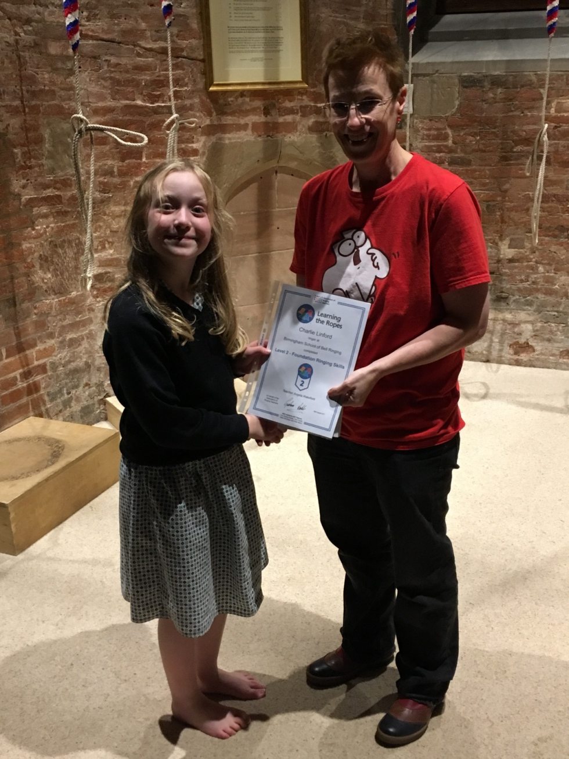
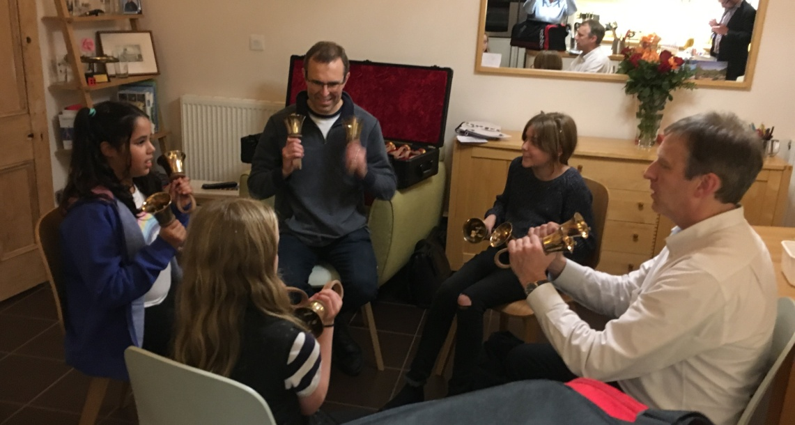
Learning the Ropes
All following LtR
Learning handbells in parallel
Certificate focus
Weekly Simba award

Slide 4
Recruitment methods
Charlie - hereditary!
Esther - Mum was a ringer at Harborne and Clare told her
Sonny - parent saw note put in church school newsletter
Orson - Sonny brought his friend
Caoimhe - Sonny’s mum brought her along
Sara - Charlie found her school friend’s dad was a bellringer
Robbie – Caoimhe brought her friend
James - Sonny’s mum recommended it to his mum

Slide 5
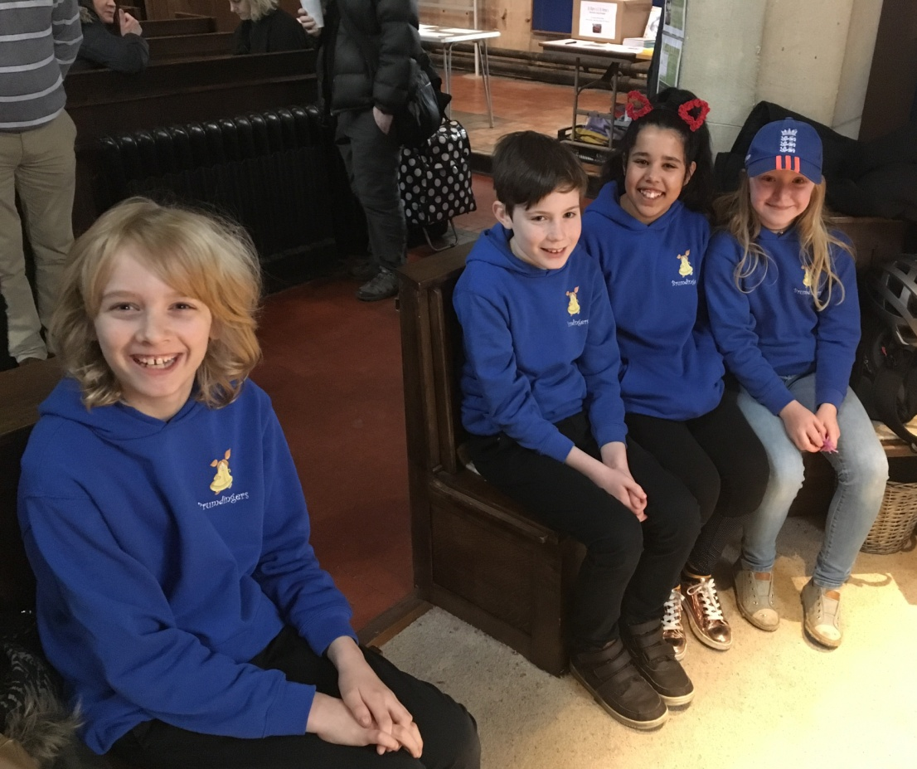
One year on…
Average attendance 7 of the 8
No one has given up
Parents are very happy
More ‘playtime’ than ‘lesson’
Debut at Christingle service
Monthly ‘Church Parade’
RWNYC entry!
‘Church Parade’

Slide 8
Other activities!
We build Jenga towers out of caramel wafer bars
We give each other piggy backs
We play tickle monster
Play the piano
Piggy in the middle
We drop Caoimhe on the hard stone floor

Slide 9
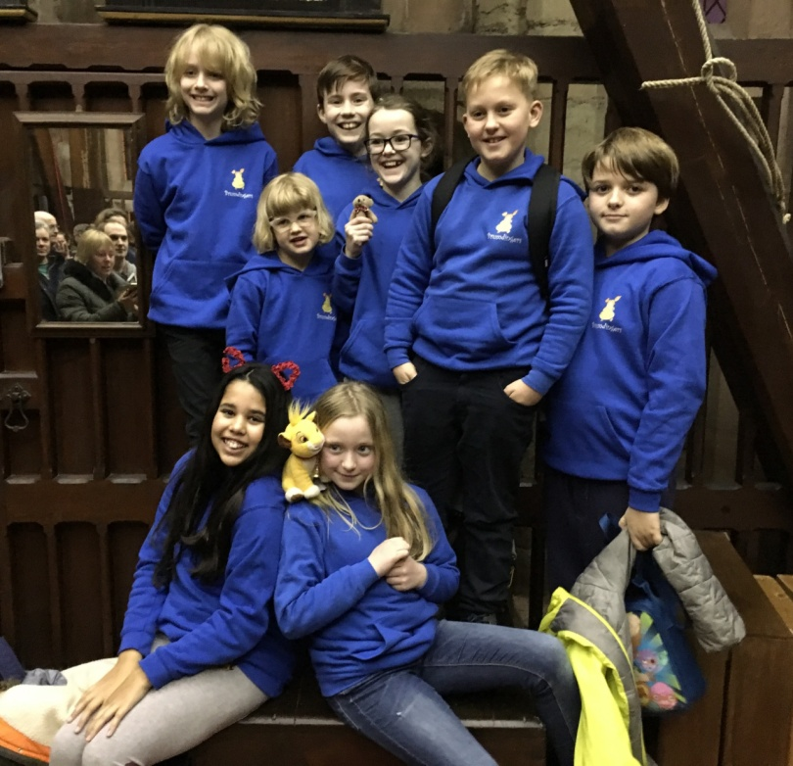
I look forward to the caramel wafers - robbie
You can’t rush perfection - caoimhe
Its brilliant and I like it - orson
Its fun - sara
“ ” james
(a boy of few words)
Its marvellous and magnificent - sonny
it’s the highlight of the week and I can’t wait to come - charlie

Slide 10
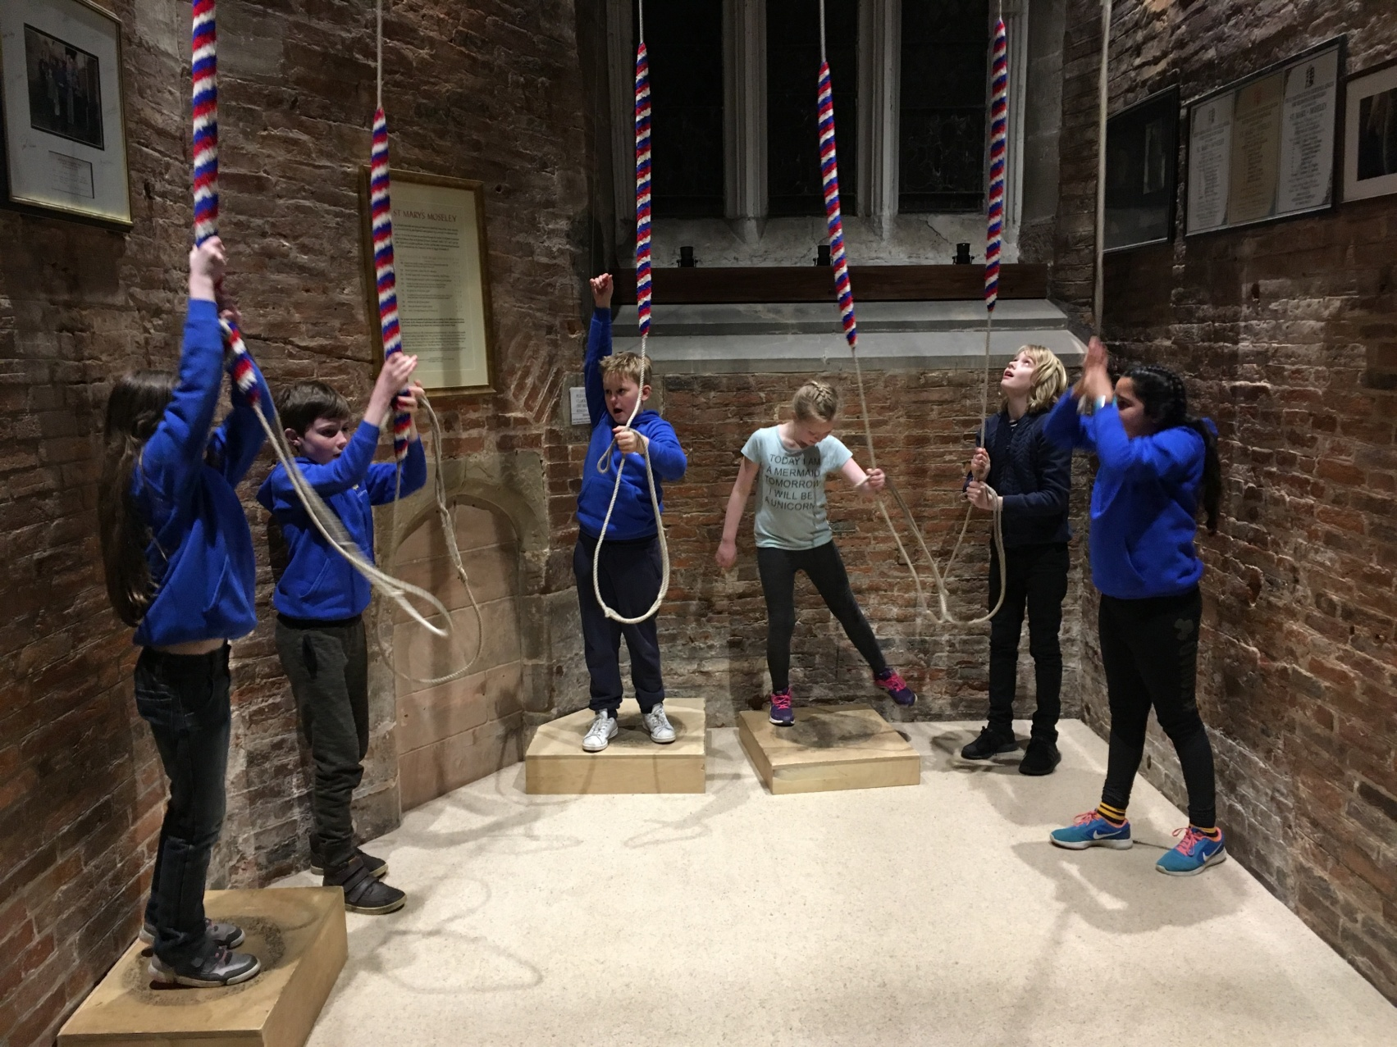
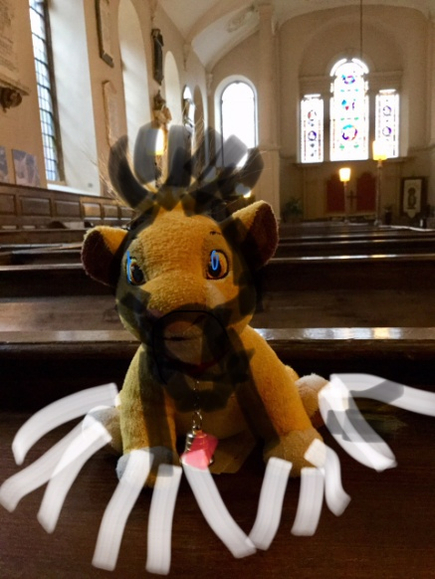
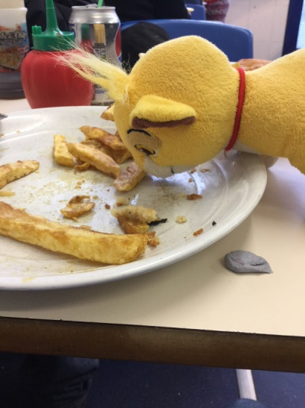
#simbawarriors!

Slide 11
Challenges
Keep them all at same level of let some get ahead?
Starting another batch
Bells too difficult!
Not really enough rope time, but balancing fun
Integrating different ages

