Slide 1
Developing
Youth Teams
Linda Garton and John Loveless

Slide 2
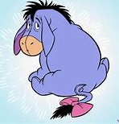
Why?
Safeguarding requirements make it far too difficult
There are no young ringers in our area
It’s a waste of time … they will be going off to university soon
They are too busy
I haven’t got time

Slide 3

Why?
It’s fun fun
fun fun fun!
We need to teach and retain young ringers to secure the future of ringing!
Young ringers enjoy ringing with other young ringers.
More likely to keep them if they ring with other young ringers
It will also be:
hard work
time consuming.
frustrating at times
But developing a youth team might just be the best and most rewarding thing you do in your ringing career!
(You may already be doing it!)

Slide 4
Our focus for today:
Youth teams at a local level:
Case studies: Campton and Clifton, Bedfordshire
Youth teams at an association/ county level :
Case Study: Bedfordshire Young Ringers
Ringing World National Youth Contest (RWNYC)
Survey of RWNYC Teams
….. Then some time for questions and to share ideas

Slide 5
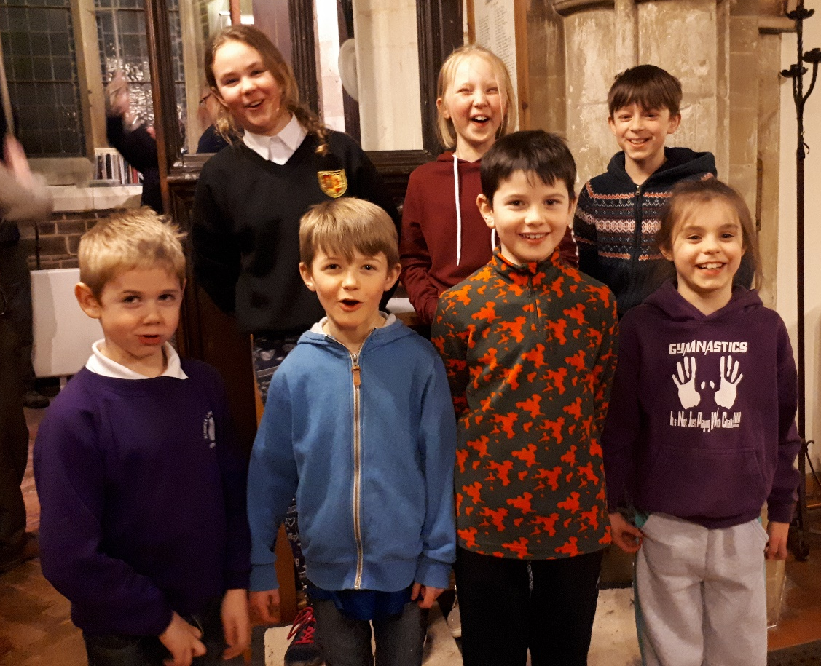
Developing a youth group as part of a local band
Campton and Clifton Bedfordshire
How have we recruited young ringers?
What do we do once we’ve got them?

Slide 6
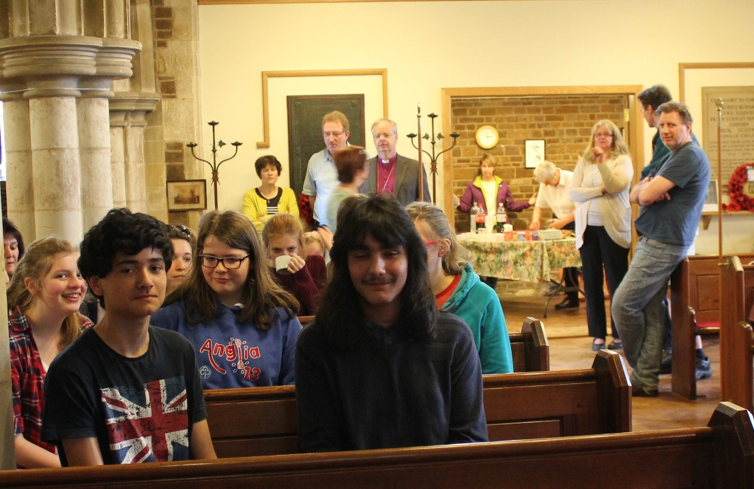
Developing a youth group as part of a local band
Factors which have helped us:
  Layout of church/tower
  Easy, light bells
  Rapid integration
  Support from local ringers
  Parental support
  Involvement in local school / community

Slide 7
Bedfordshire Young Ringers
2008 – 2012
A get together once a year on a Saturday afternoon in November
We had to find them first!
Organised by Association President
Always at Campton: bells are light & easy to ring, ground floor ring, different spaces in the church, facilities for providing refreshments, toilet.
Carousel of 3 activities:
  Tower bell ringing
  Handbell ringing (lapping)
  “Striking competition” on Abel
  Entered first RWNYC in 2011

Slide 8
Bedfordshire Young Ringers
2012 - present
RWNYC 2011 was stimulus to do more.
Monthly get together on 2nd Sunday of each month
Invitation sent out monthly by Association President to an email contact list of parents/mentors, plus to all tower captains.
Held at different towers in different parts of the county
Usually 8 bells, occasionally 10 or 12
Weight / go of bells no longer such a consideration
Somewhere for parents to wait / to have refreshments

Slide 9
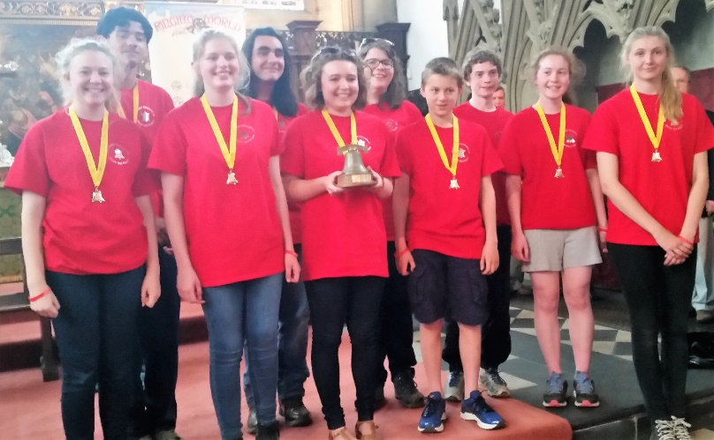
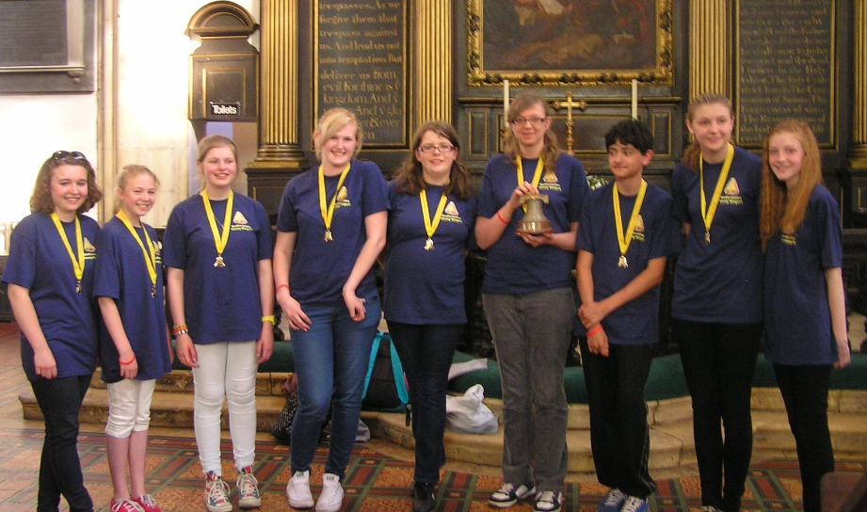
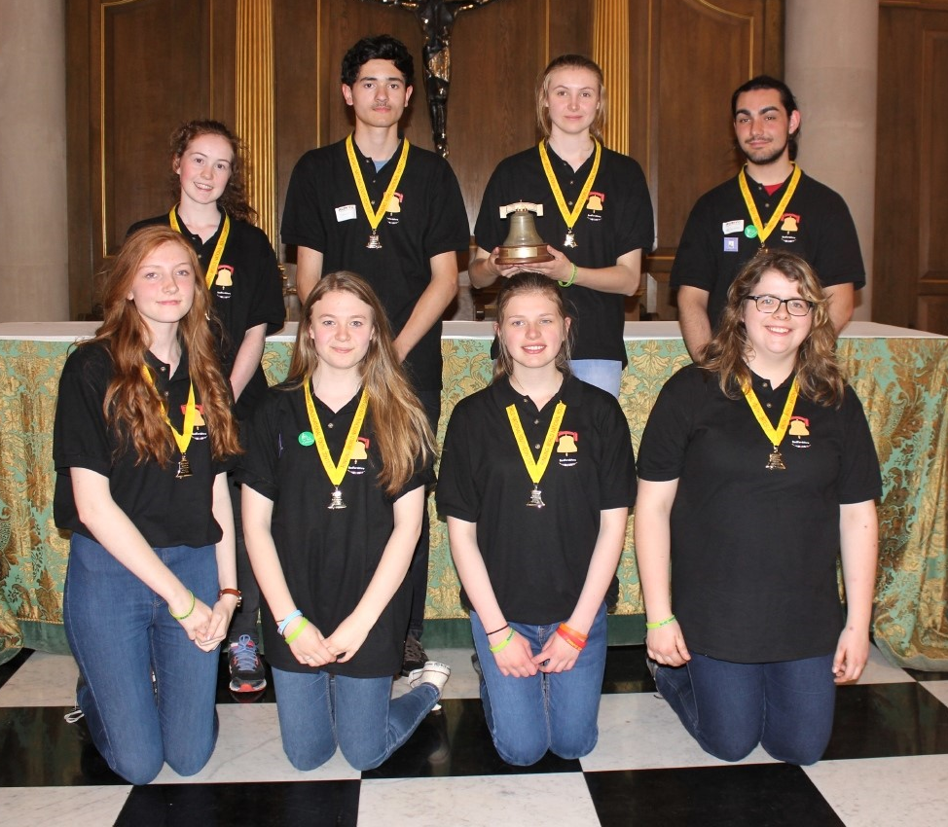
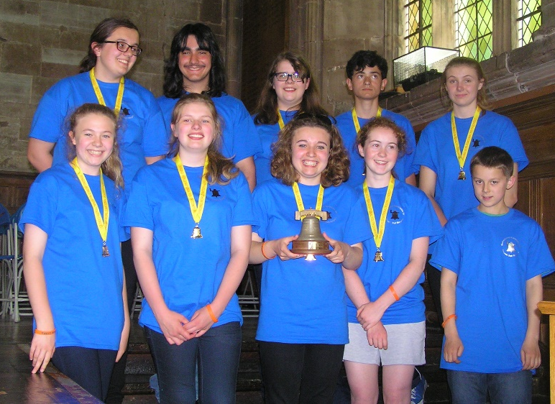
Bedfordshire Young Ringers
Oxford 2015
London 2016
York 2013
Worcester 2014

Slide 10
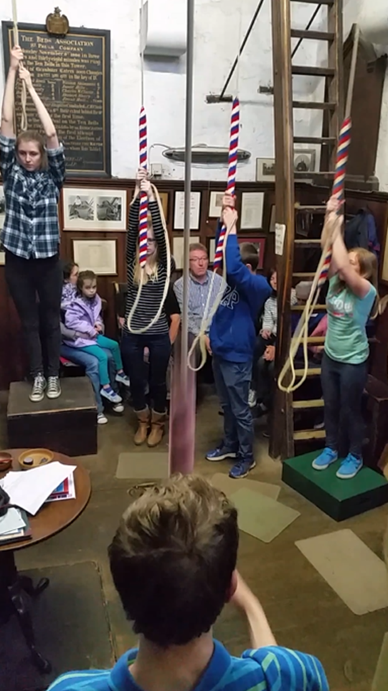
Bedfordshire Young Ringers
Reasons for success?
Regular meetings (monthly)
Bedfordshire is a relatively small county
RWNYC – aspiration to be in the team
Supportive adults - parents / mentors
High expectations / constructive criticism
Opportunities to do new things / challenges:
Annual outing
“Firsts Day”
Bedford spin off - practices/ Quarter Peals on higher numbers

Slide 11
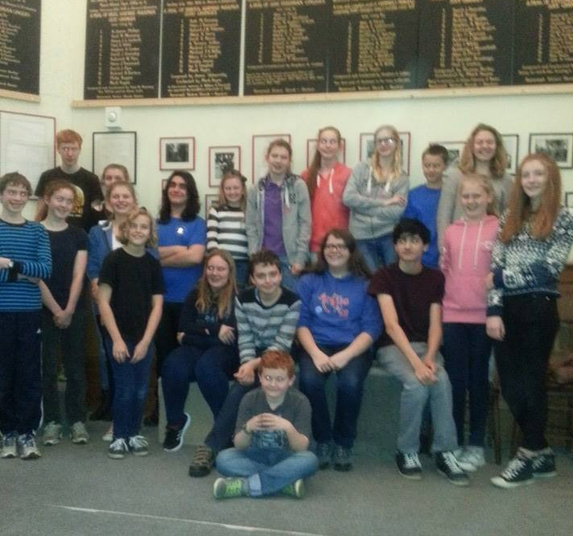

Slide 12
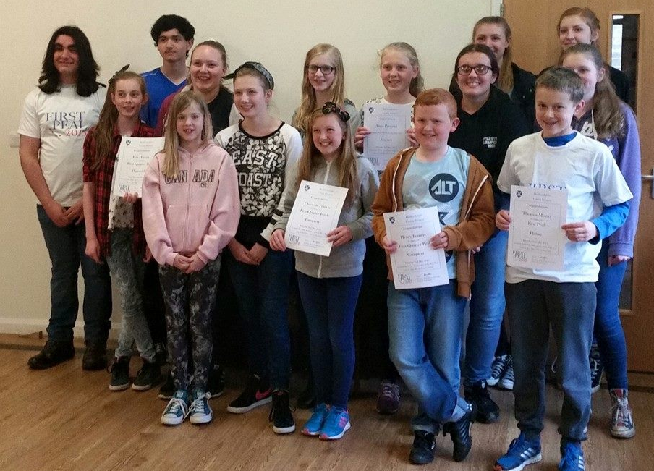
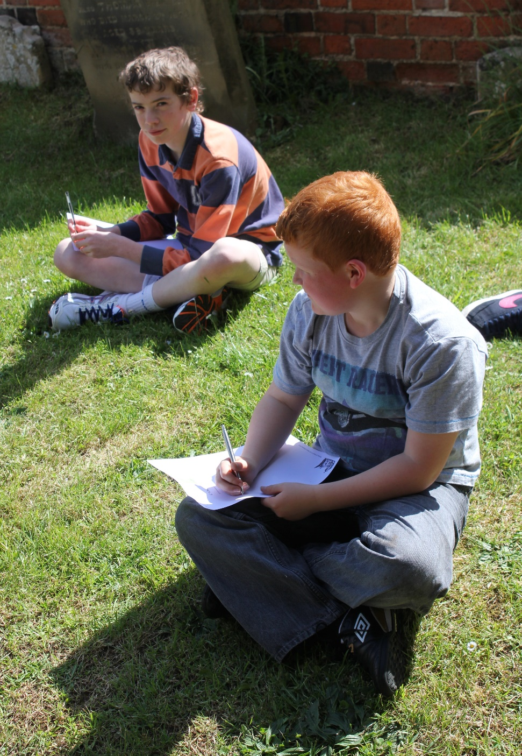

Slide 13

RWNYC
London 2018 – Saturday 7 July
Hosted by Southwark Cathedral Society of Ringers
3 qualifying heats in the morning
Top 2 teams from each qualifier go through to the final at St James Garlickhythe (Royal Jubilee Bells ) in the afternoon
Lots of other activities

Slide 14

RWNYC 2018 Teams (22)
Bath & Wells | Leicester Rising Ringers
Bedfordshire Young Ringers | Lincolnshire Gamekeepers
Brumdingers | Lincolnshire Poachers
Bucks and Berks Young Ringers | Oxford DG
Coventry Spires | Surrey Young Ringers
Derbyshire Young Ringers | Sussex Young Ringers
Essex Young Eagles | The G&B
Fen Tigers | W&P Youths
GDGYR | Worcester Cathedral
Go Bellistic! (SDGR) | Yorkshire Tykes
Kent Young Ringers | Young @ Herts

Slide 15
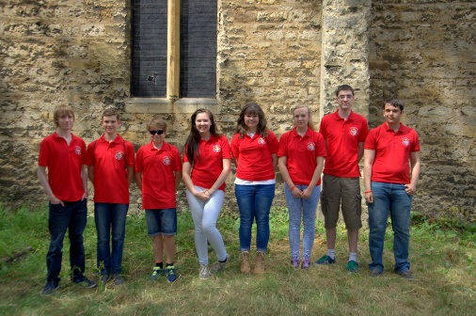
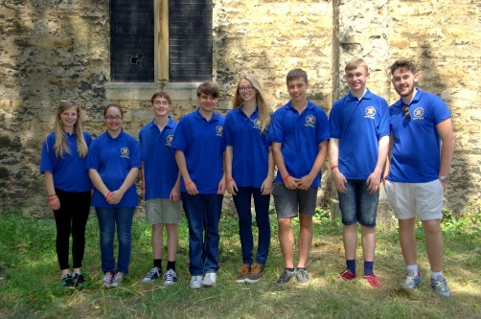
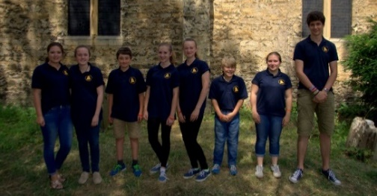
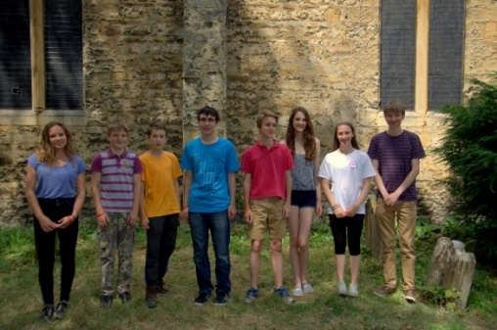
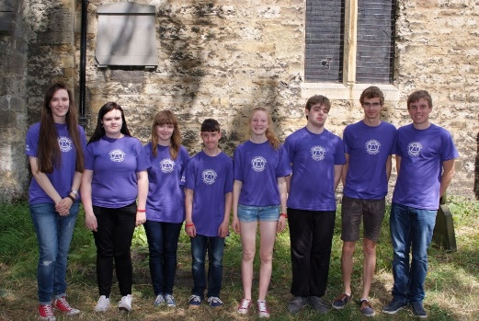
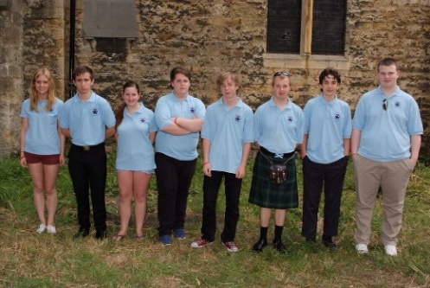
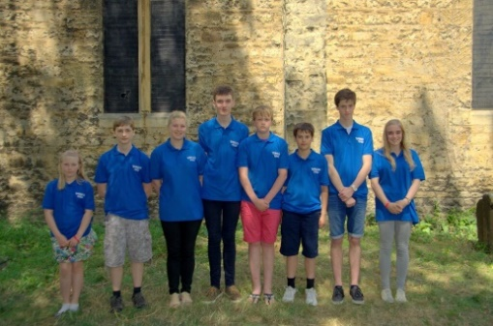
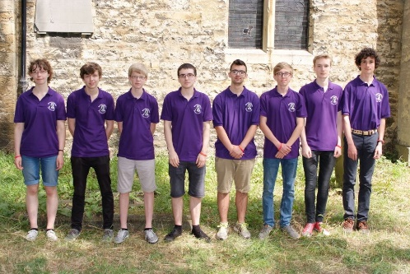
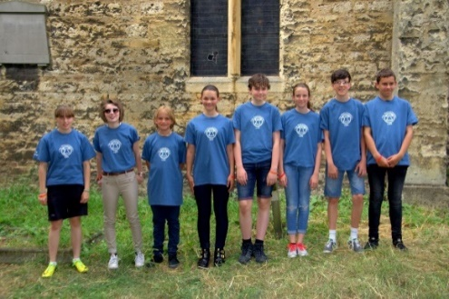
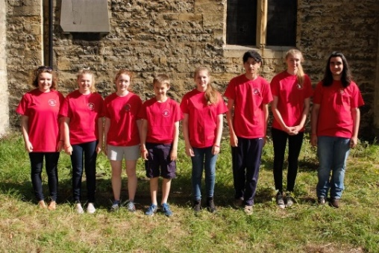
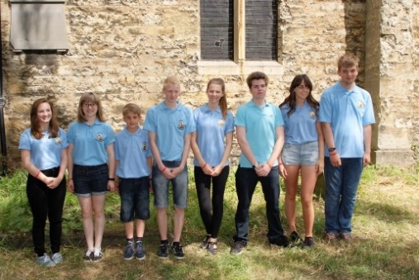
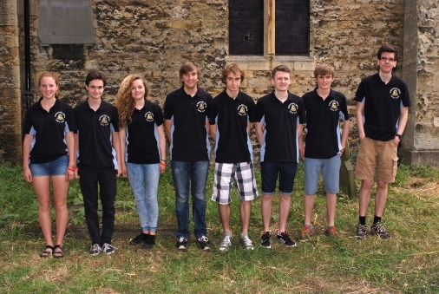
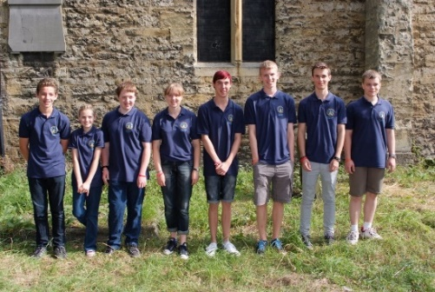
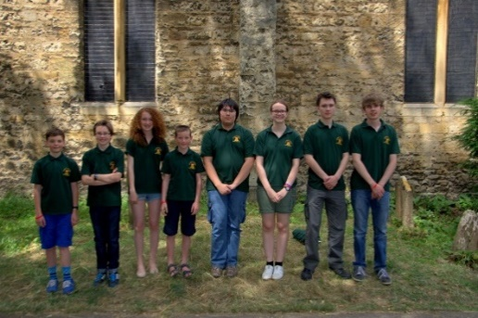
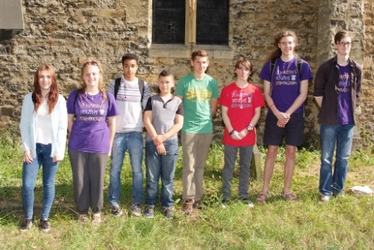
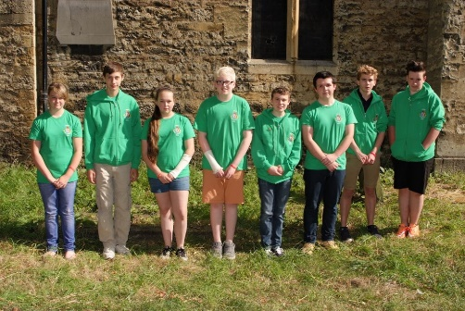
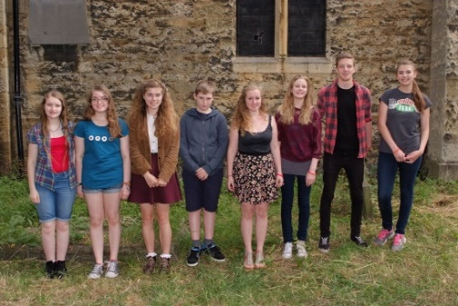
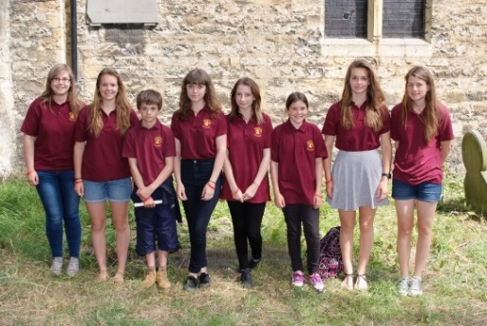
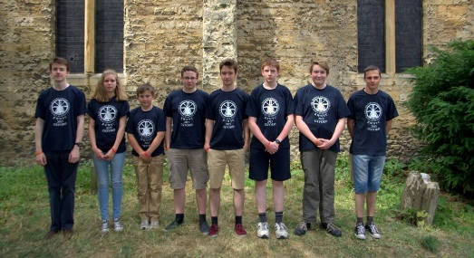
RWNYC
Teams
Oxford
July 2015

Slide 16
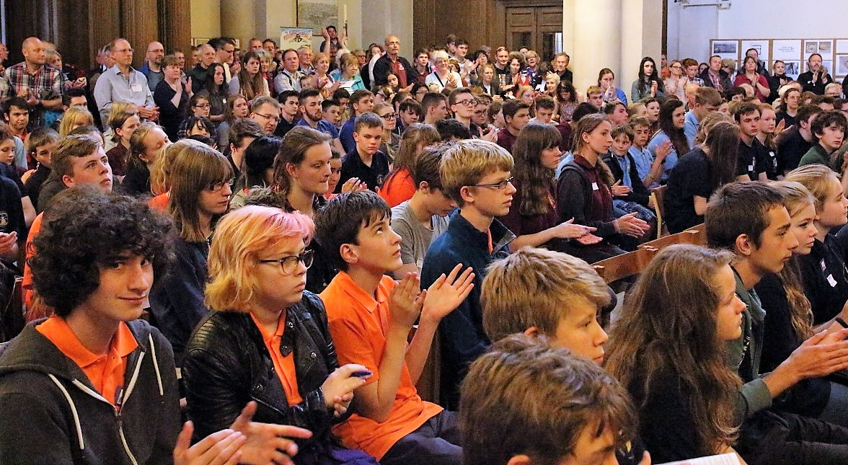

Slide 17
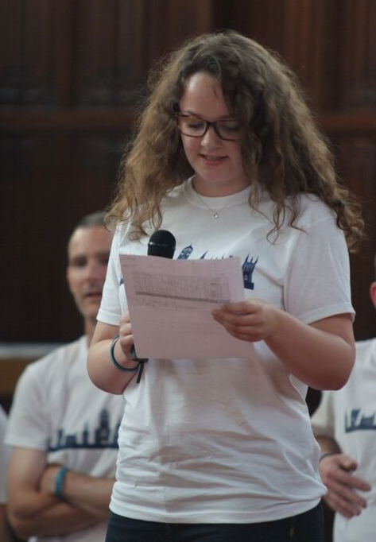
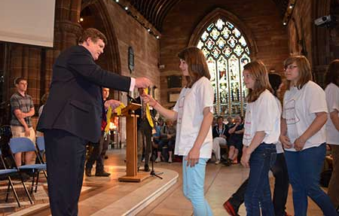

Every team is awarded a grade, and all team members are presented with a silver or gold medal.

Slide 18
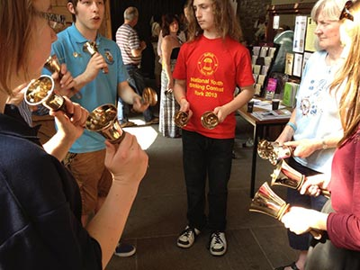
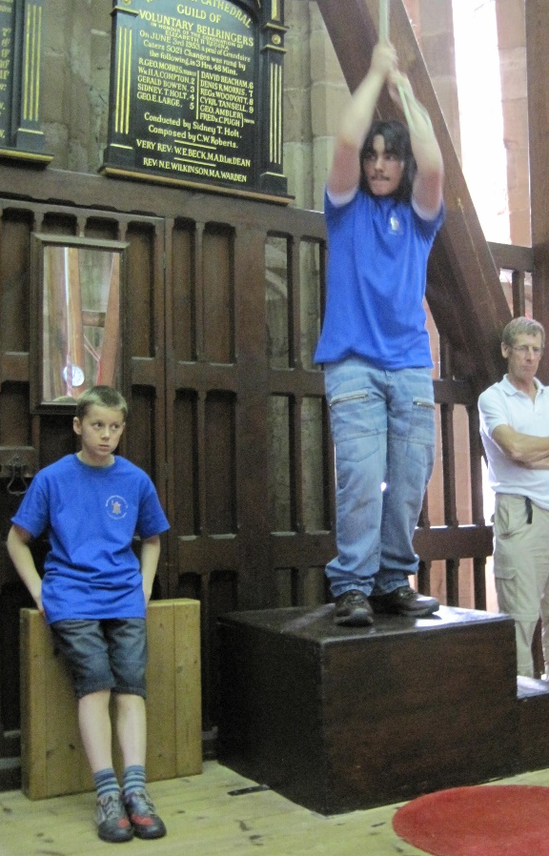

Slide 19
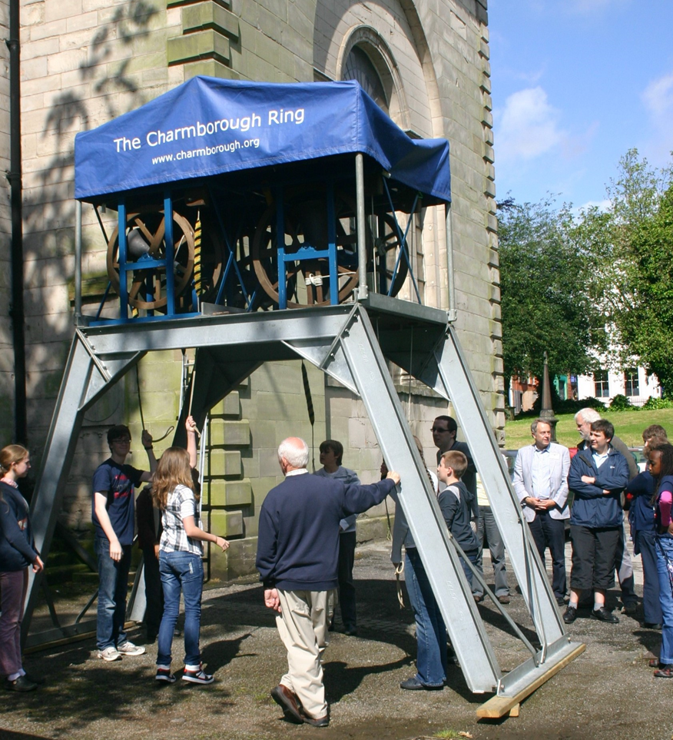
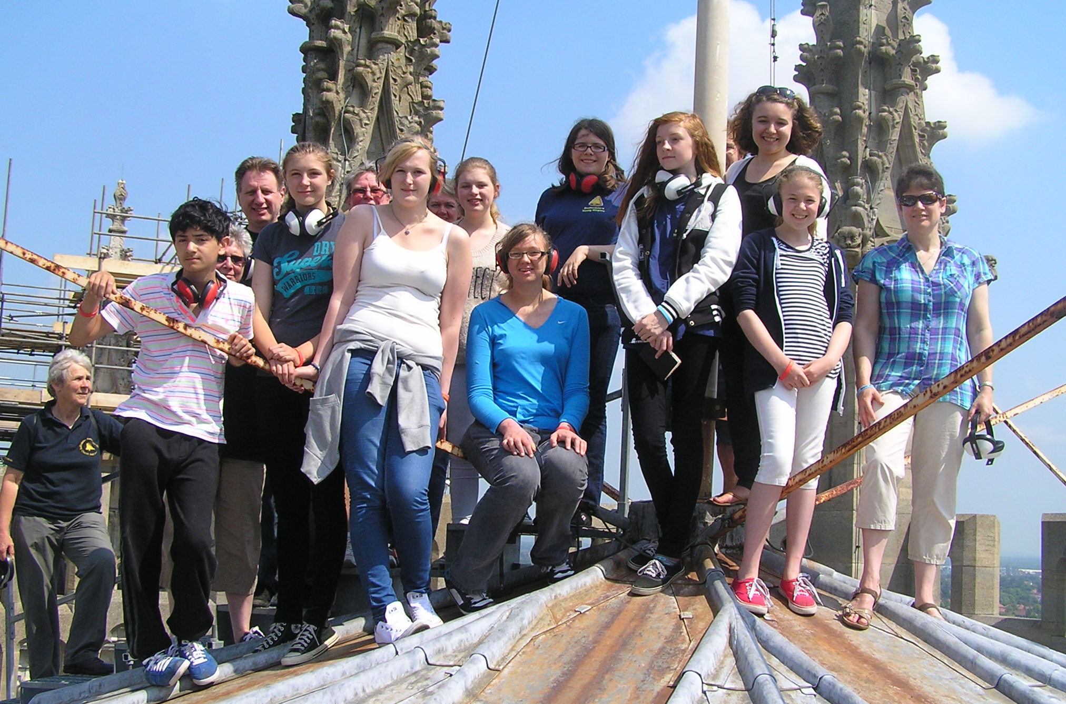
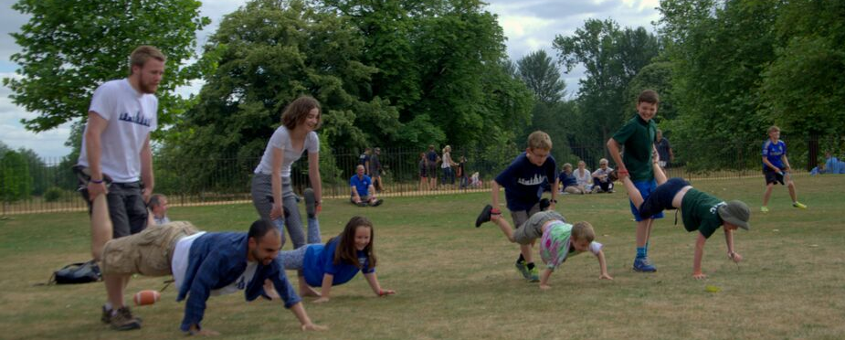


Slide 20
Survey of RWNYC Teams (11 responses from 22 teams)
To what extent has the RWNYC acted as a catalyst for the development of your youth group?
Frequency and day/time of meetings?
Size of group (young ringers /adult helpers)?
Activities?
What works well? … “top tips”!
And what doesn’t work?

Slide 21
Was the RWNYC a catalyst?

Slide 22
Frequency of meetings

Slide 23
Day and time of meetings

Slide 24
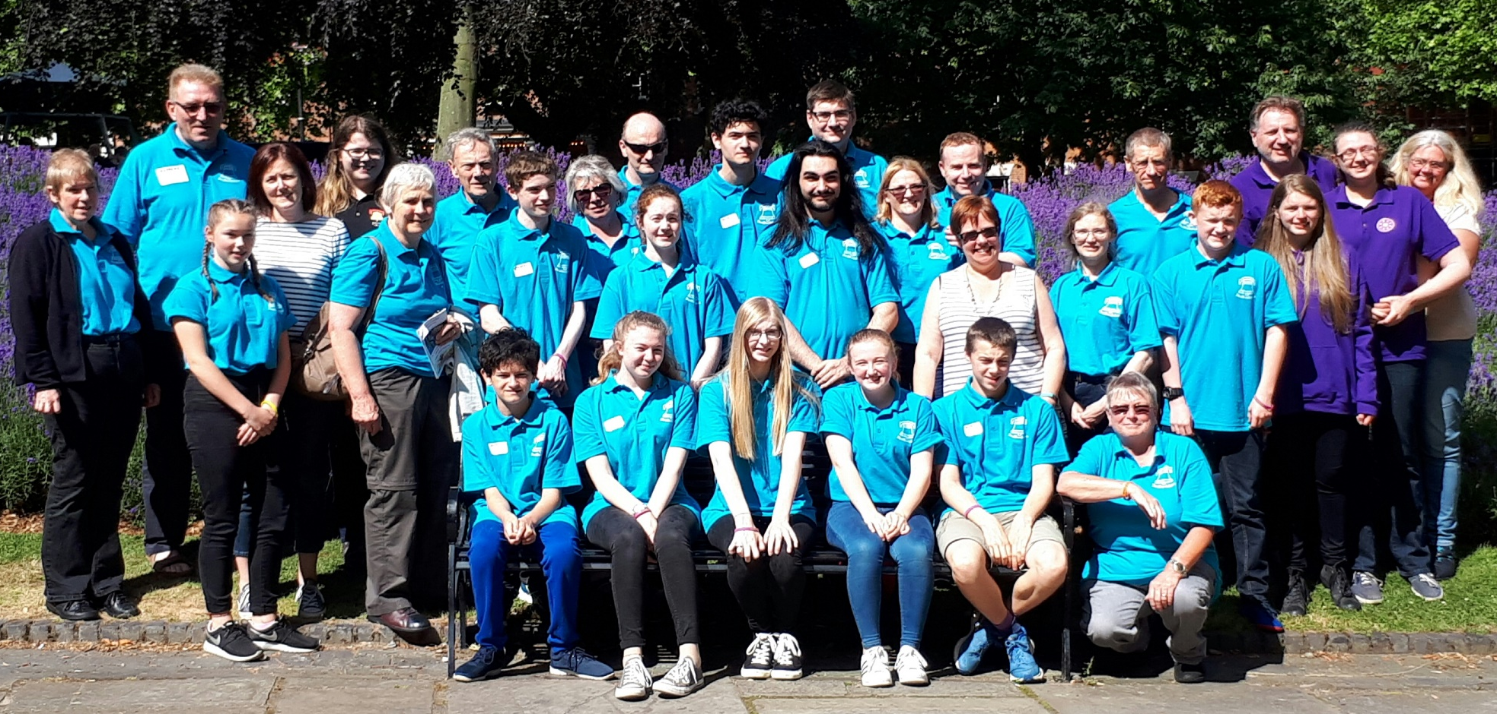
Size of group (Definition: Some groups define “young ringers” as 25 and under)
Young ringers :
10 – 25 members
Average 15 attendees
Plus
Between 2-8 adult helpers

Slide 25
Activities … Ringing!
Practices
  Cater for all abilities
  Most teams practice at different towers
  Run by adult or young ringer?

Slide 26
Activities … Ringing!
  Quarters and peals
  Opportunities for 1 or 2 youngsters to develop with an experienced band
  Ringing outings
  one day - weekend or school holidays
  weekend away
  outing with picnic
  ringing at prestigious towers

Slide 27
Activities - Refreshments!
cakes
tub of sweets
drinks
pizza
meal out together
Important for:
socialising
parents whilst waiting
Timing:
during practice?
after practice?

Slide 28
Other activities?
Only 2 out of the 11 teams organise non-ringing activities
You do not need to organise non-ringing events to keep them keen!
We tried social activities (bowling) but, for some, mixing with people they do not know can be a bit daunting.
You don't need to "entertain" a young ringer. The best young ringers go ringing because they ringing. By having a Youth Team, those young ringers who have doubts about their ringing will be swept along by the "ringing nutters" in your group!!!!! It will happen - so you just have to be the catalyst.

Slide 29
Top tips!
Importance of parents / mentors:
Safeguarding and safety in the tower
Transport
Communicating arrangements
Extent of adult involvement in the ringing?
Run the ringing?
Provide structure and support?

Slide 30
Role of parents and mentors
Get parents involved to spread workload and to encourage attendance
Commitment from individuals and parents difficult, especially if from a non ringing background.
The youngsters haven't got full control over their lives, so although they might like to do something they might not be able to (and things can change at the last minute due to family commitments)
We let our young ringers get on with it. The adults are there only for safeguarding and safety. We do not push the young ringers; We don't think 'pushy touch line parents' help in competitions or other ringing events.

Slide 31
More Top Tips!
Treat young ringers like adults!
High expectations / challenges
Young ringers take it in turns to run the practice?
Don’t worry if they don’t talk to each other!
Face to face invitations
Choose your helpers
eg those just too old to be a “young ringer”
”The Game”!
Have fun!

Slide 32
What doesn’t work?
Having too many adults (Ban them to a nearby teashop!)
Don’t send out general invitations or expect Association Officers to do the recruitment for you because it won’t happen.
Putting the youngsters in charge.
A break for food and drink in the middle of the practice. (Wastes time/dietary needs to cope with)
Trying to get commitment from non-ringing parents
Trying to do it all on your own

Slide 33
Summary
Essential that we develop young ringers
Ringing with other young ringers helps retention
Value and utilise adult ringers
Support of parents / mentors is vital
Develop your own strategy to fit your local situation.
Enjoy it!

Slide 34
Over to you!
Any questions?
Any comments?
Anything to share?

